Slide 1
Lyon County Board of County Commissioners
Noxious Weeds
Informative Update
Sean Gephart
Noxious Weeds Coordinator
Nevada Department of Agriculture

Slide 2
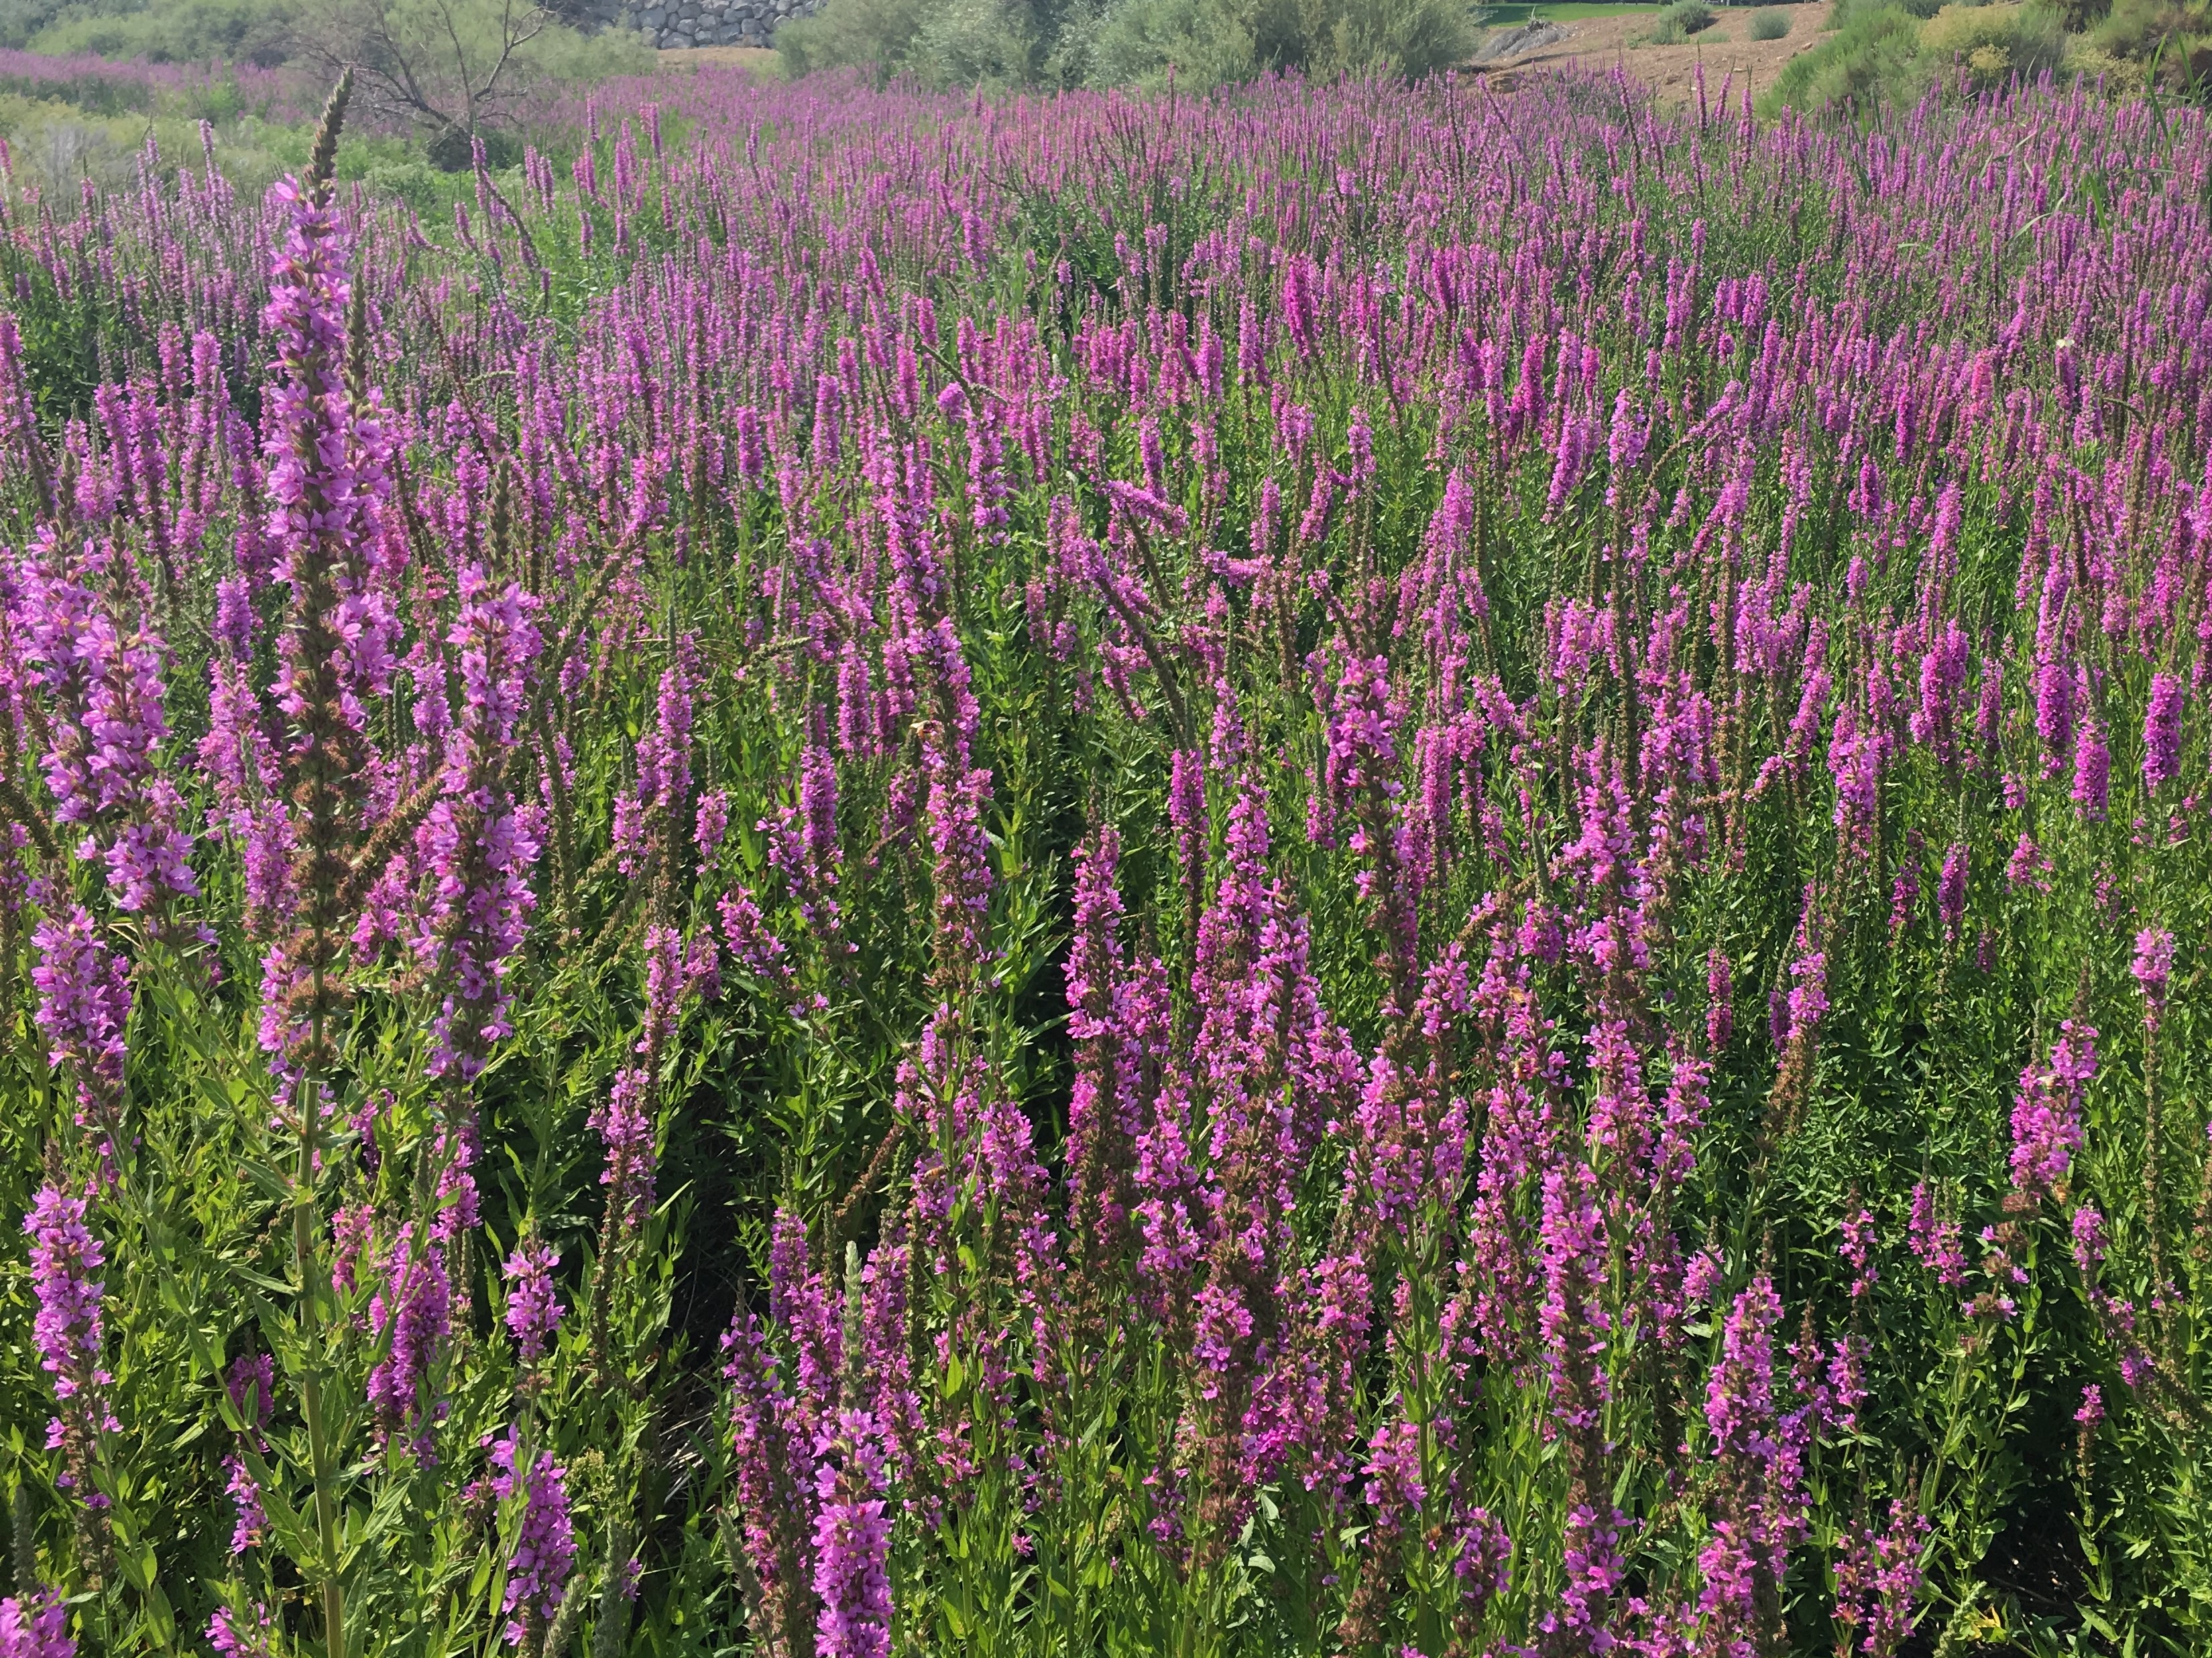
State Laws Regulating Noxious Weeds
Noxious Weed Defined:
NRS 555.005: “Any species of plant which is, or is likely to be, a public nuisance, detrimental or destructive and difficult to control”
Introduced Through: feed, seeds, ornamentals

Slide 3
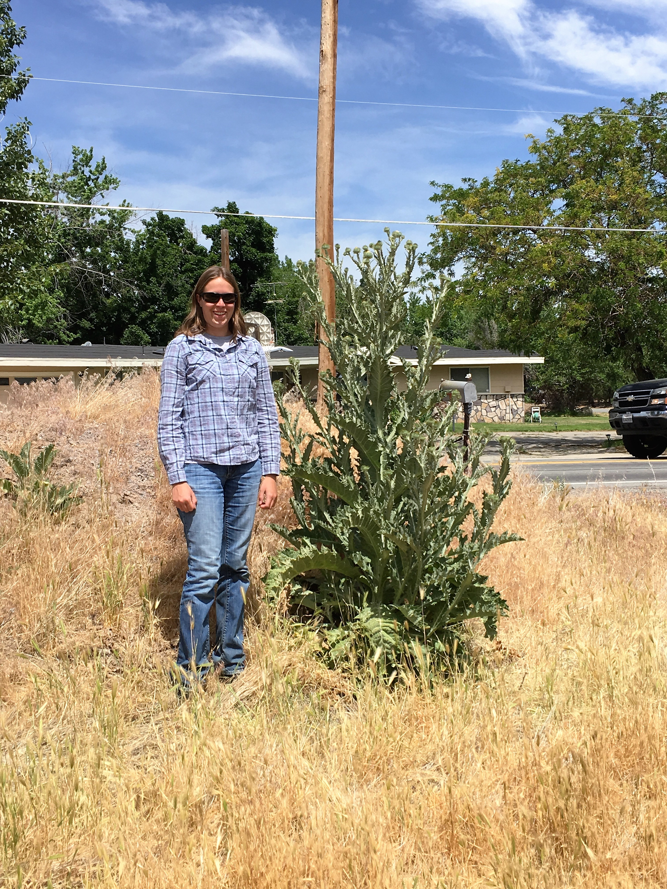
State Laws Regulating Noxious Weeds
Nevada Department of Agriculture’s Authority
NRS 555.130:
Designation of Noxious Weeds
The state may declare certain weeds as noxious if such species are likely to be destructive and difficult to control but not so wide spread that their control is impossible.

Slide 4
State Laws Regulating Noxious Weeds
NAC 555.010: Designation and Categorization of Noxious Weeds
There are 54 weeds currently listed as noxious.
The noxious weeds are broken down into three categories: A, B, C
A: Limited distribution
B: Established in certain areas
C: Widespread throughout state

Slide 5
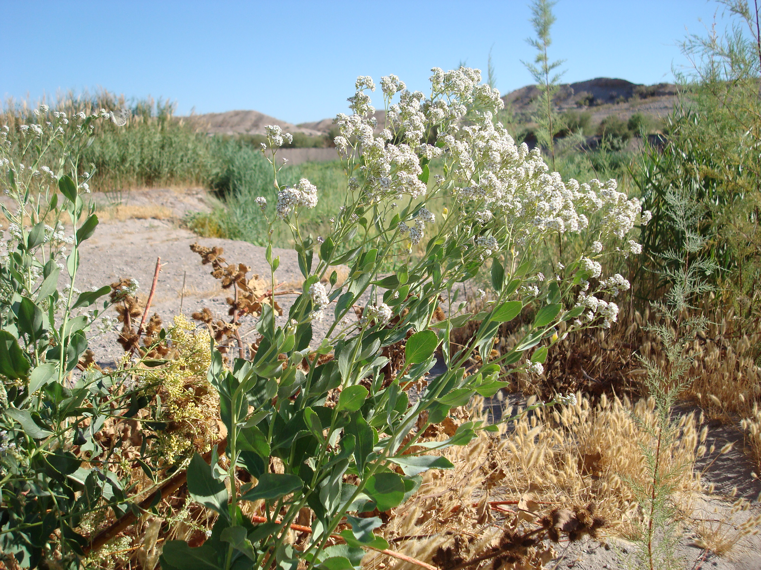
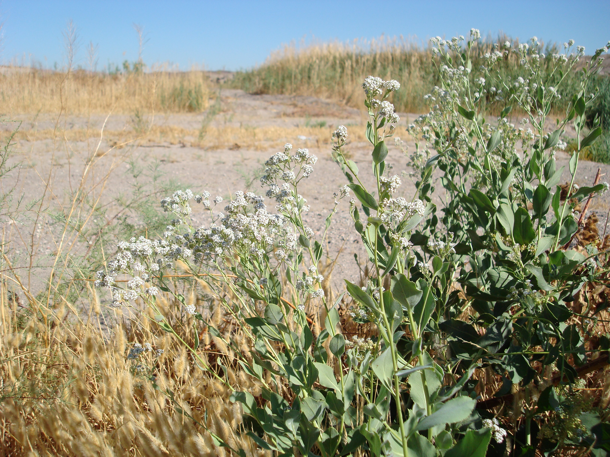
State Laws Regulating Noxious Weeds
NRS 555.150:Control of Noxious Weeds by Owner or Occupant of Land:
Every person owning, controlling or occupying lands in the state and every county shall control all weeds declared noxious.

Slide 6
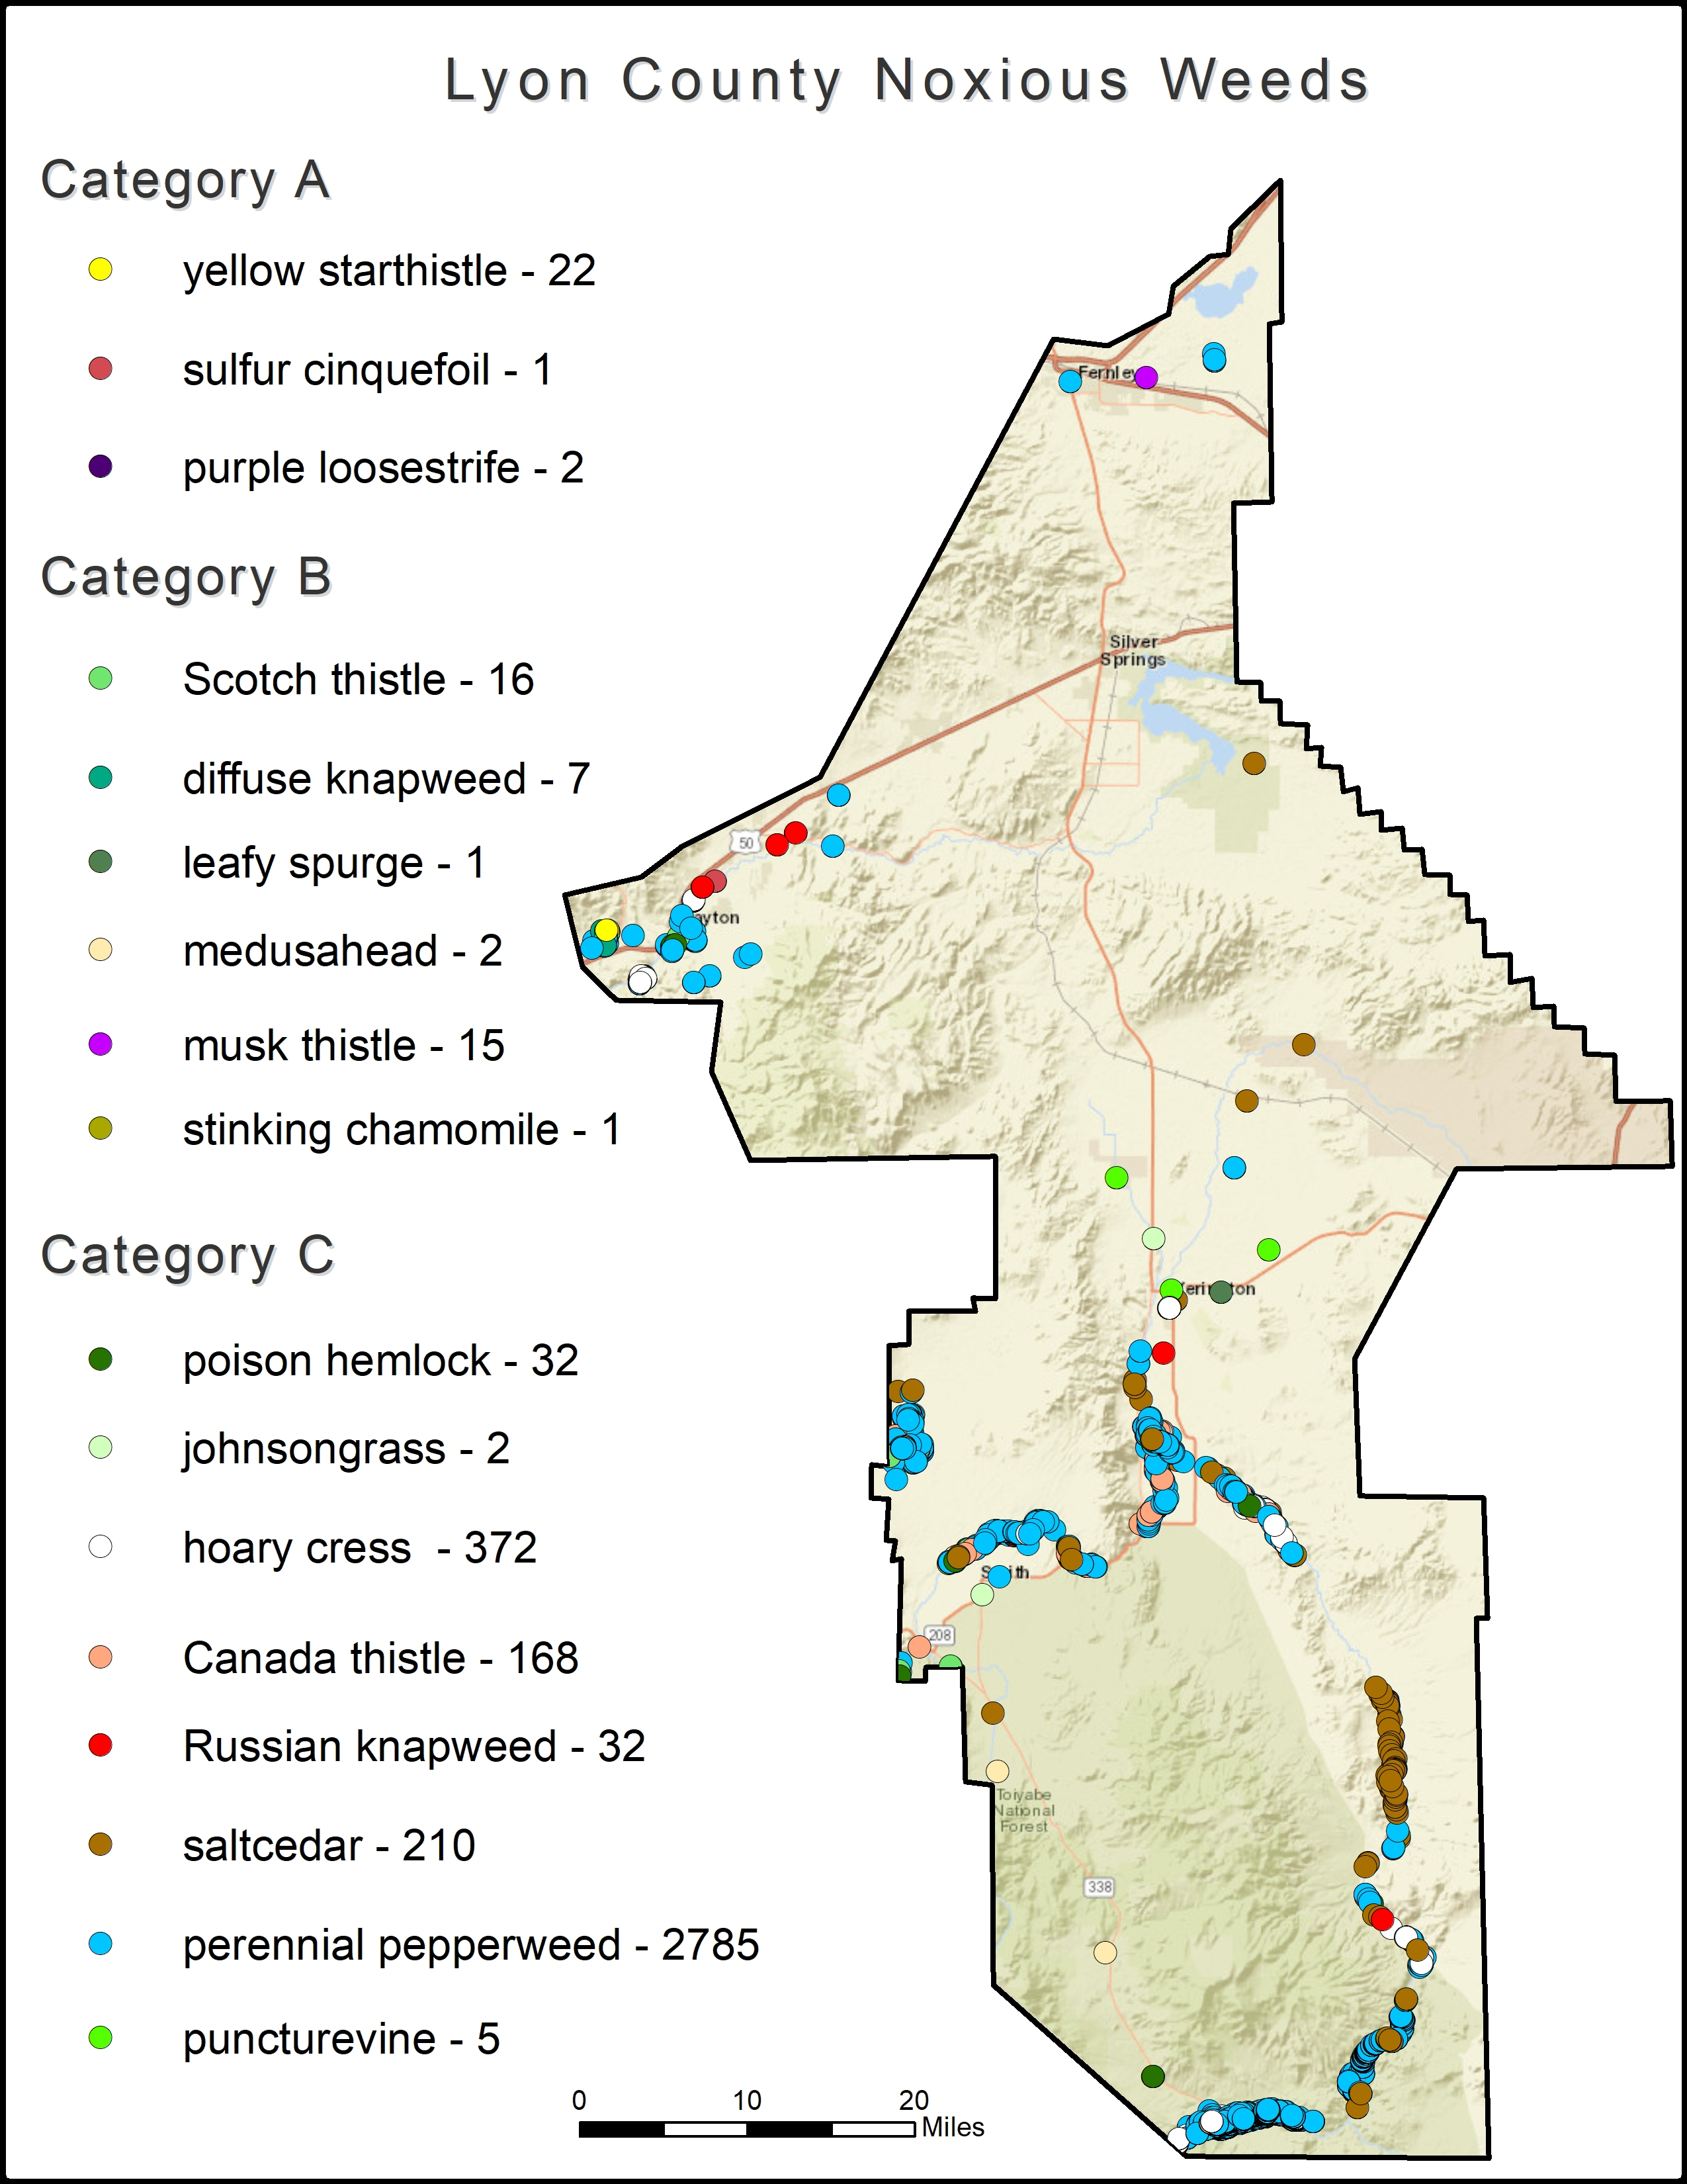
Lyon County Noxious Weeds Data
GIS Mapping Data:
Map generated 2019
Data Collection Since 2014
Survey and Complaint Driven
Using EddMaps Cell Phone App.
App available for use by county
Points very is size and infestation
Points Collected: Public & Private
Multi Public Agency Collaboration Requested

Slide 7
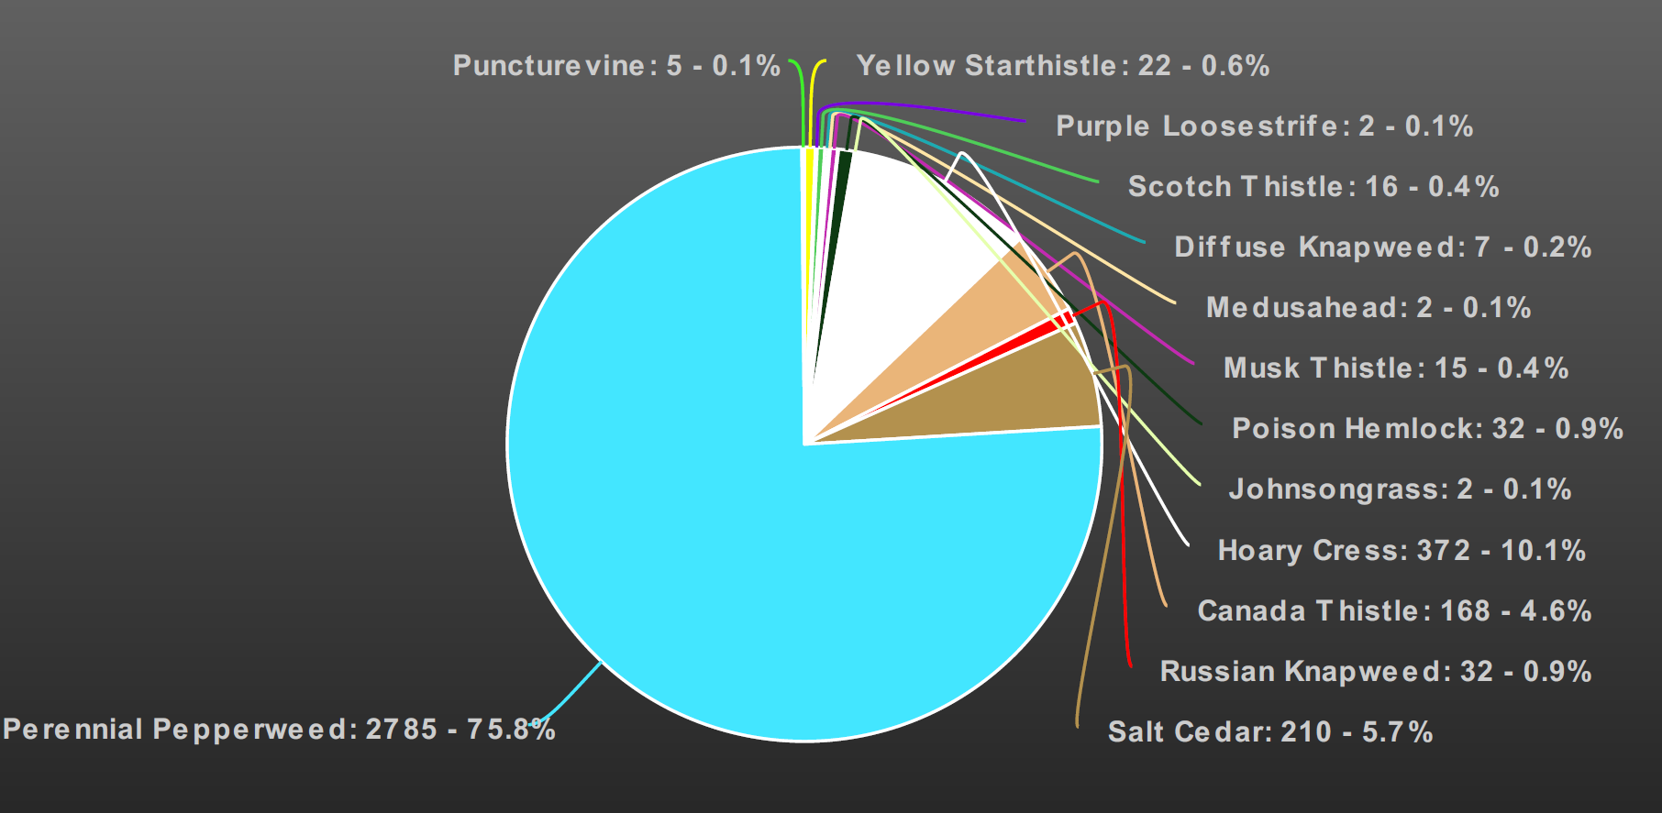

Slide 8
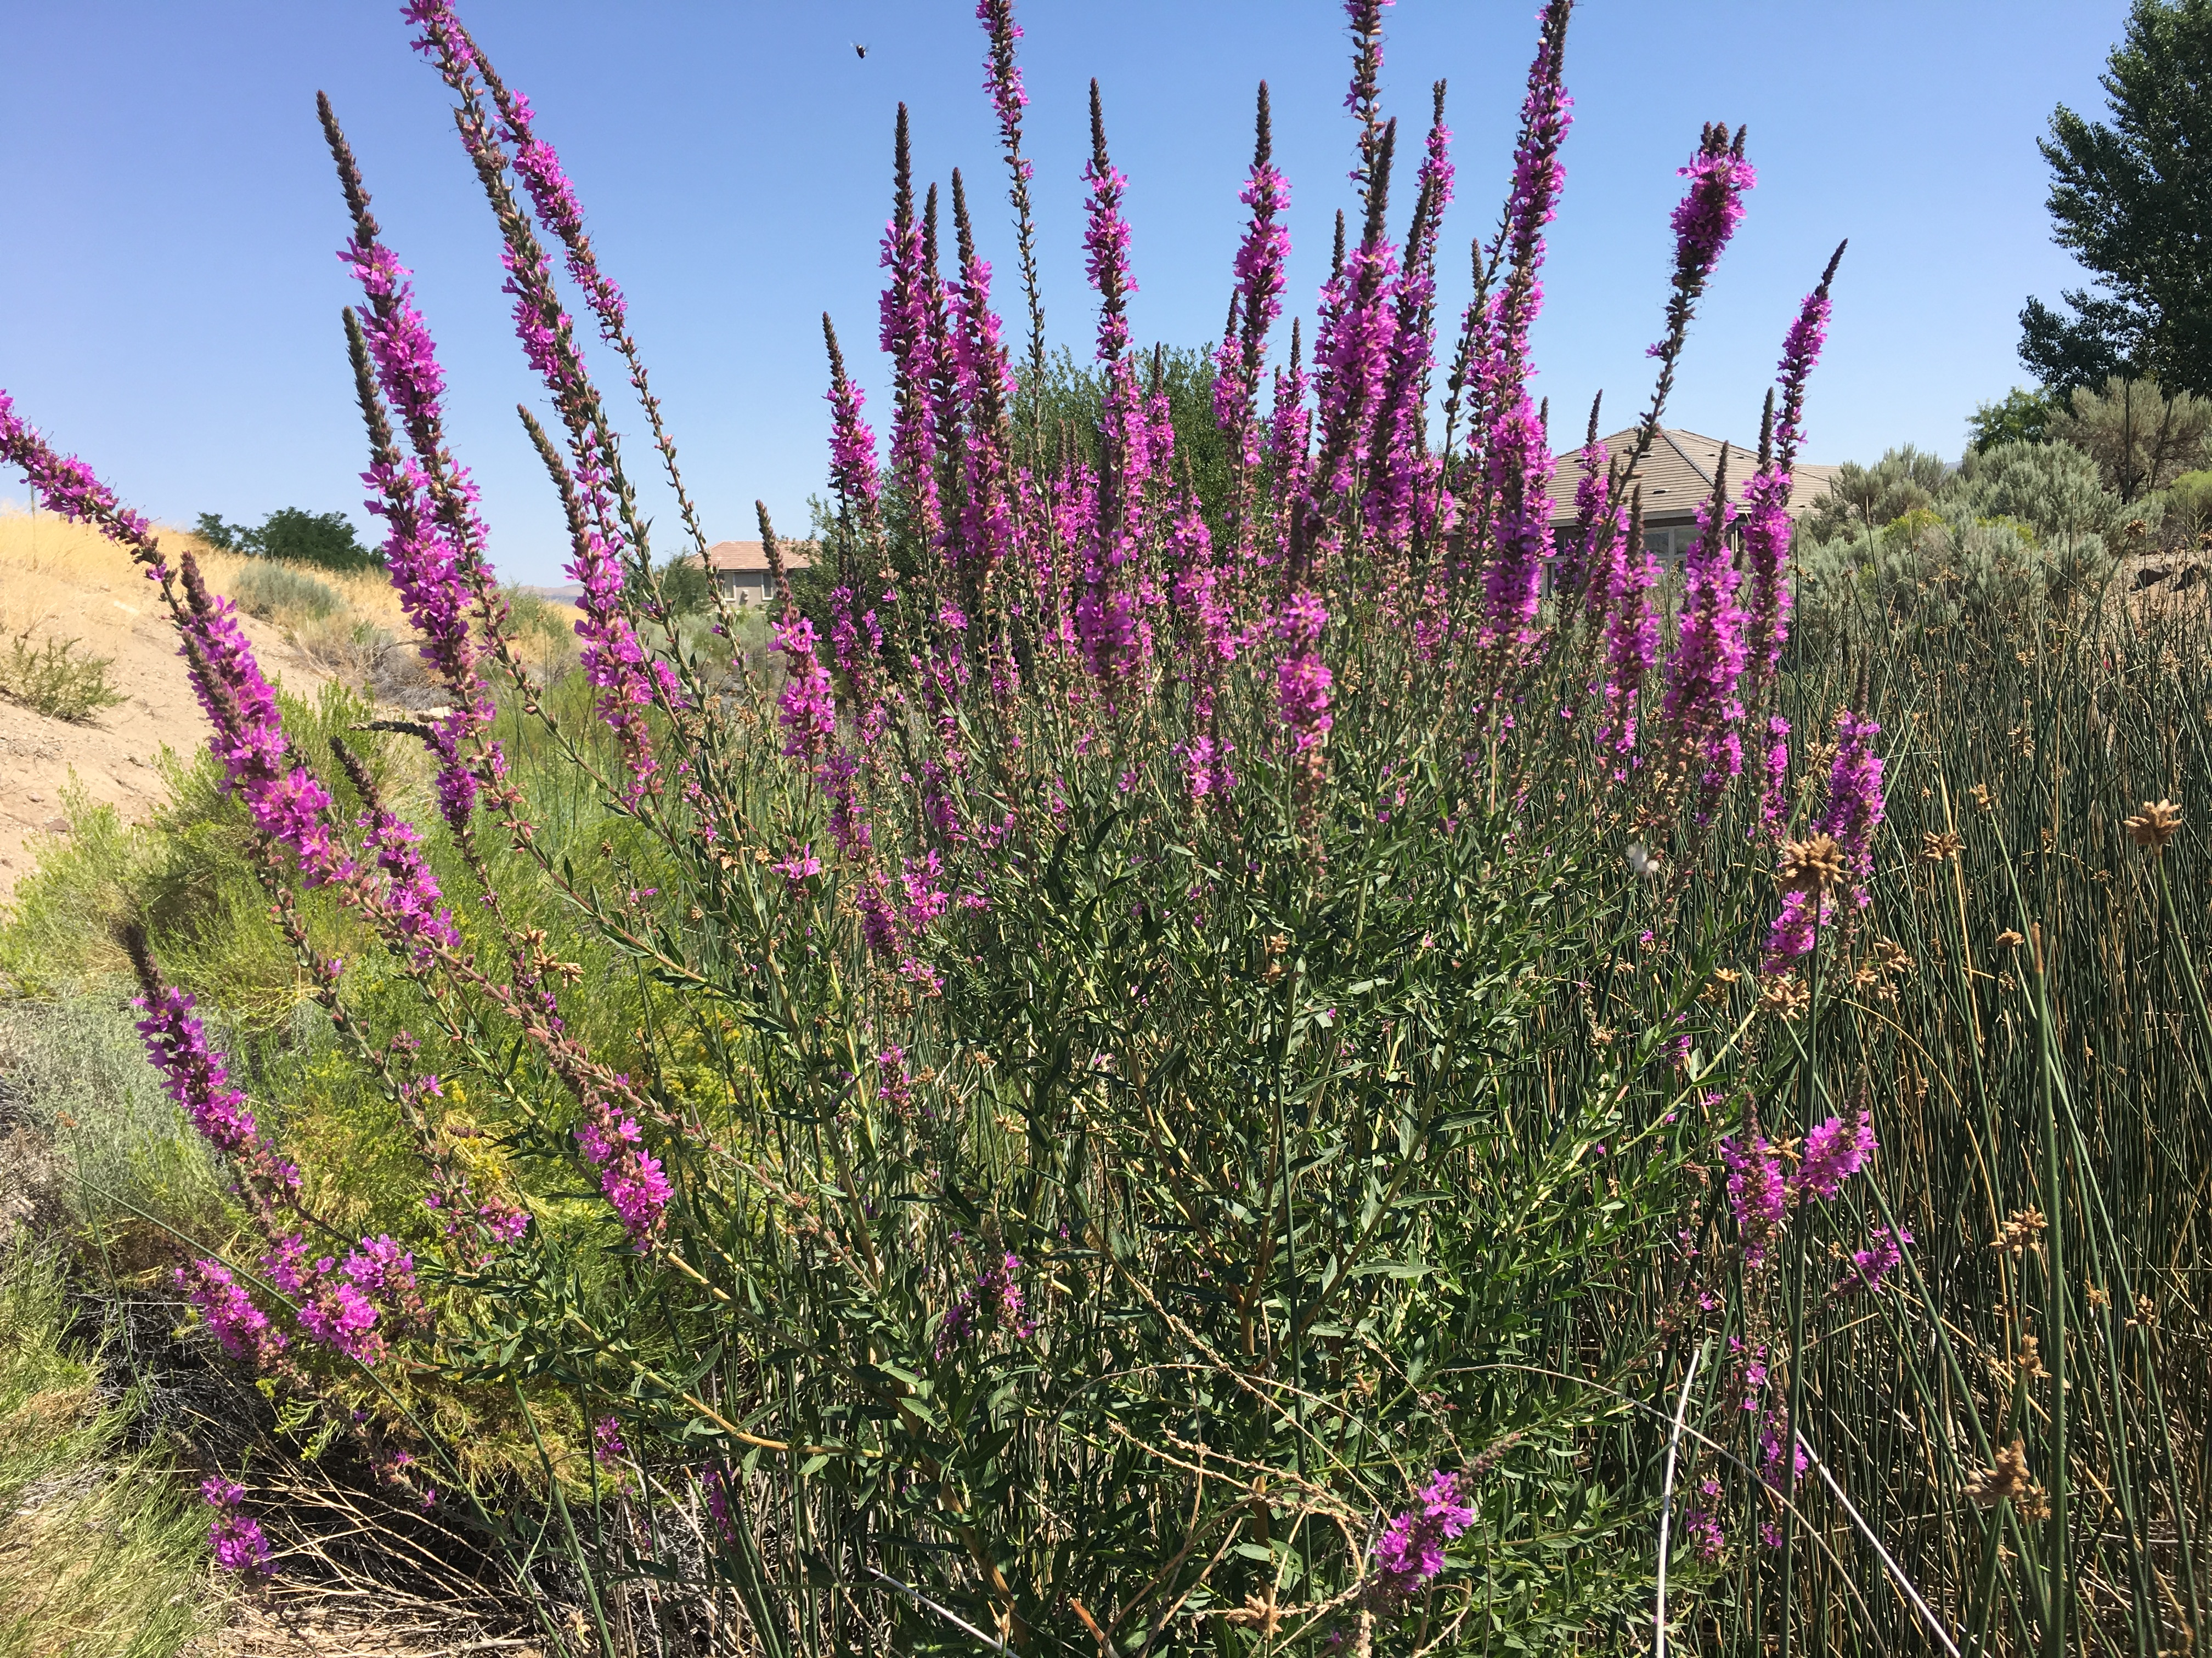
Identified Noxious Weeds
Purple Lossestrife:
Perennial
Riparian species, Carson and Truckee River Concern
Spread by seed, up to 2 million a year
Biological agent available
Repeated hand removal can be effective
Herbicide use a concern due to water habitat

Slide 9
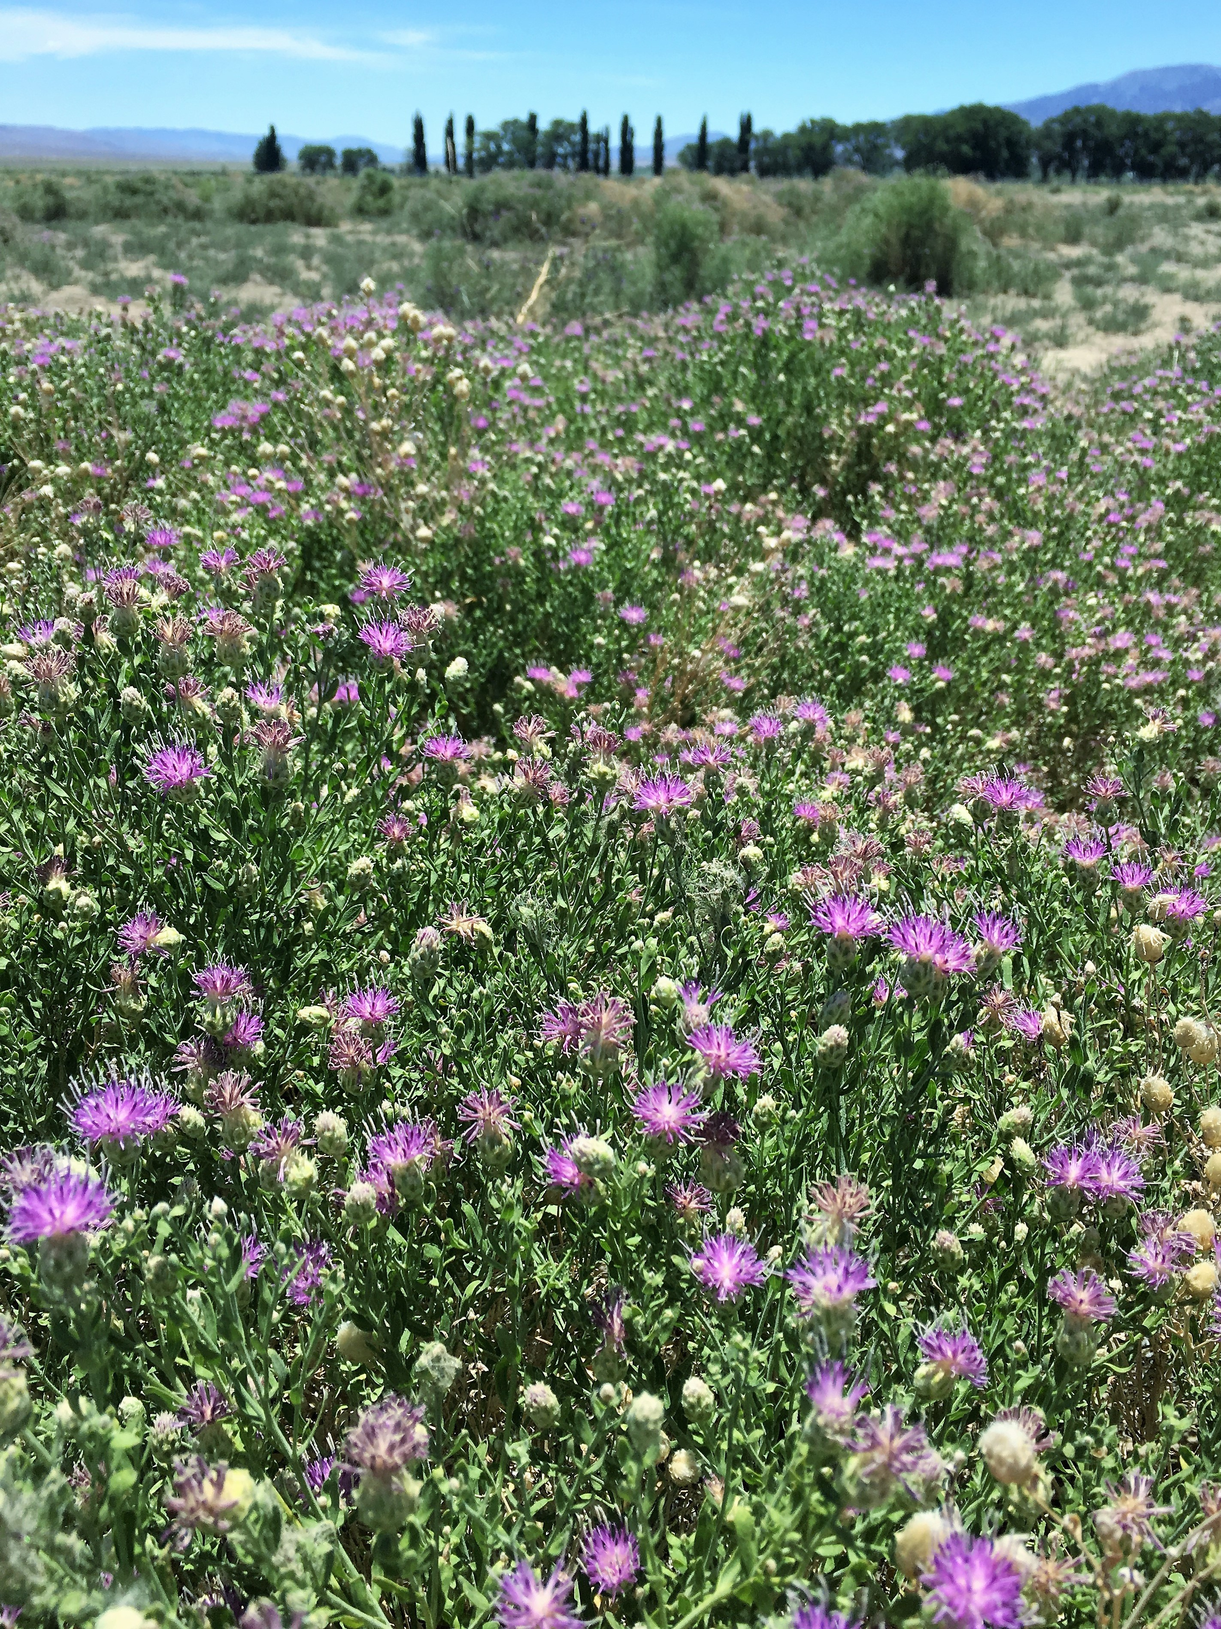
Identified Noxious Weeds
Russian Knapweed:
Perennial
Spread by Roots and Seeds
Toxic to horses causing Chewing Disease: Dehydration and Starvation
Mowing and Tilling NOT effective due to creeping root system and dormant seed germination
More than 1 Herbicide Applications Needed

Slide 10
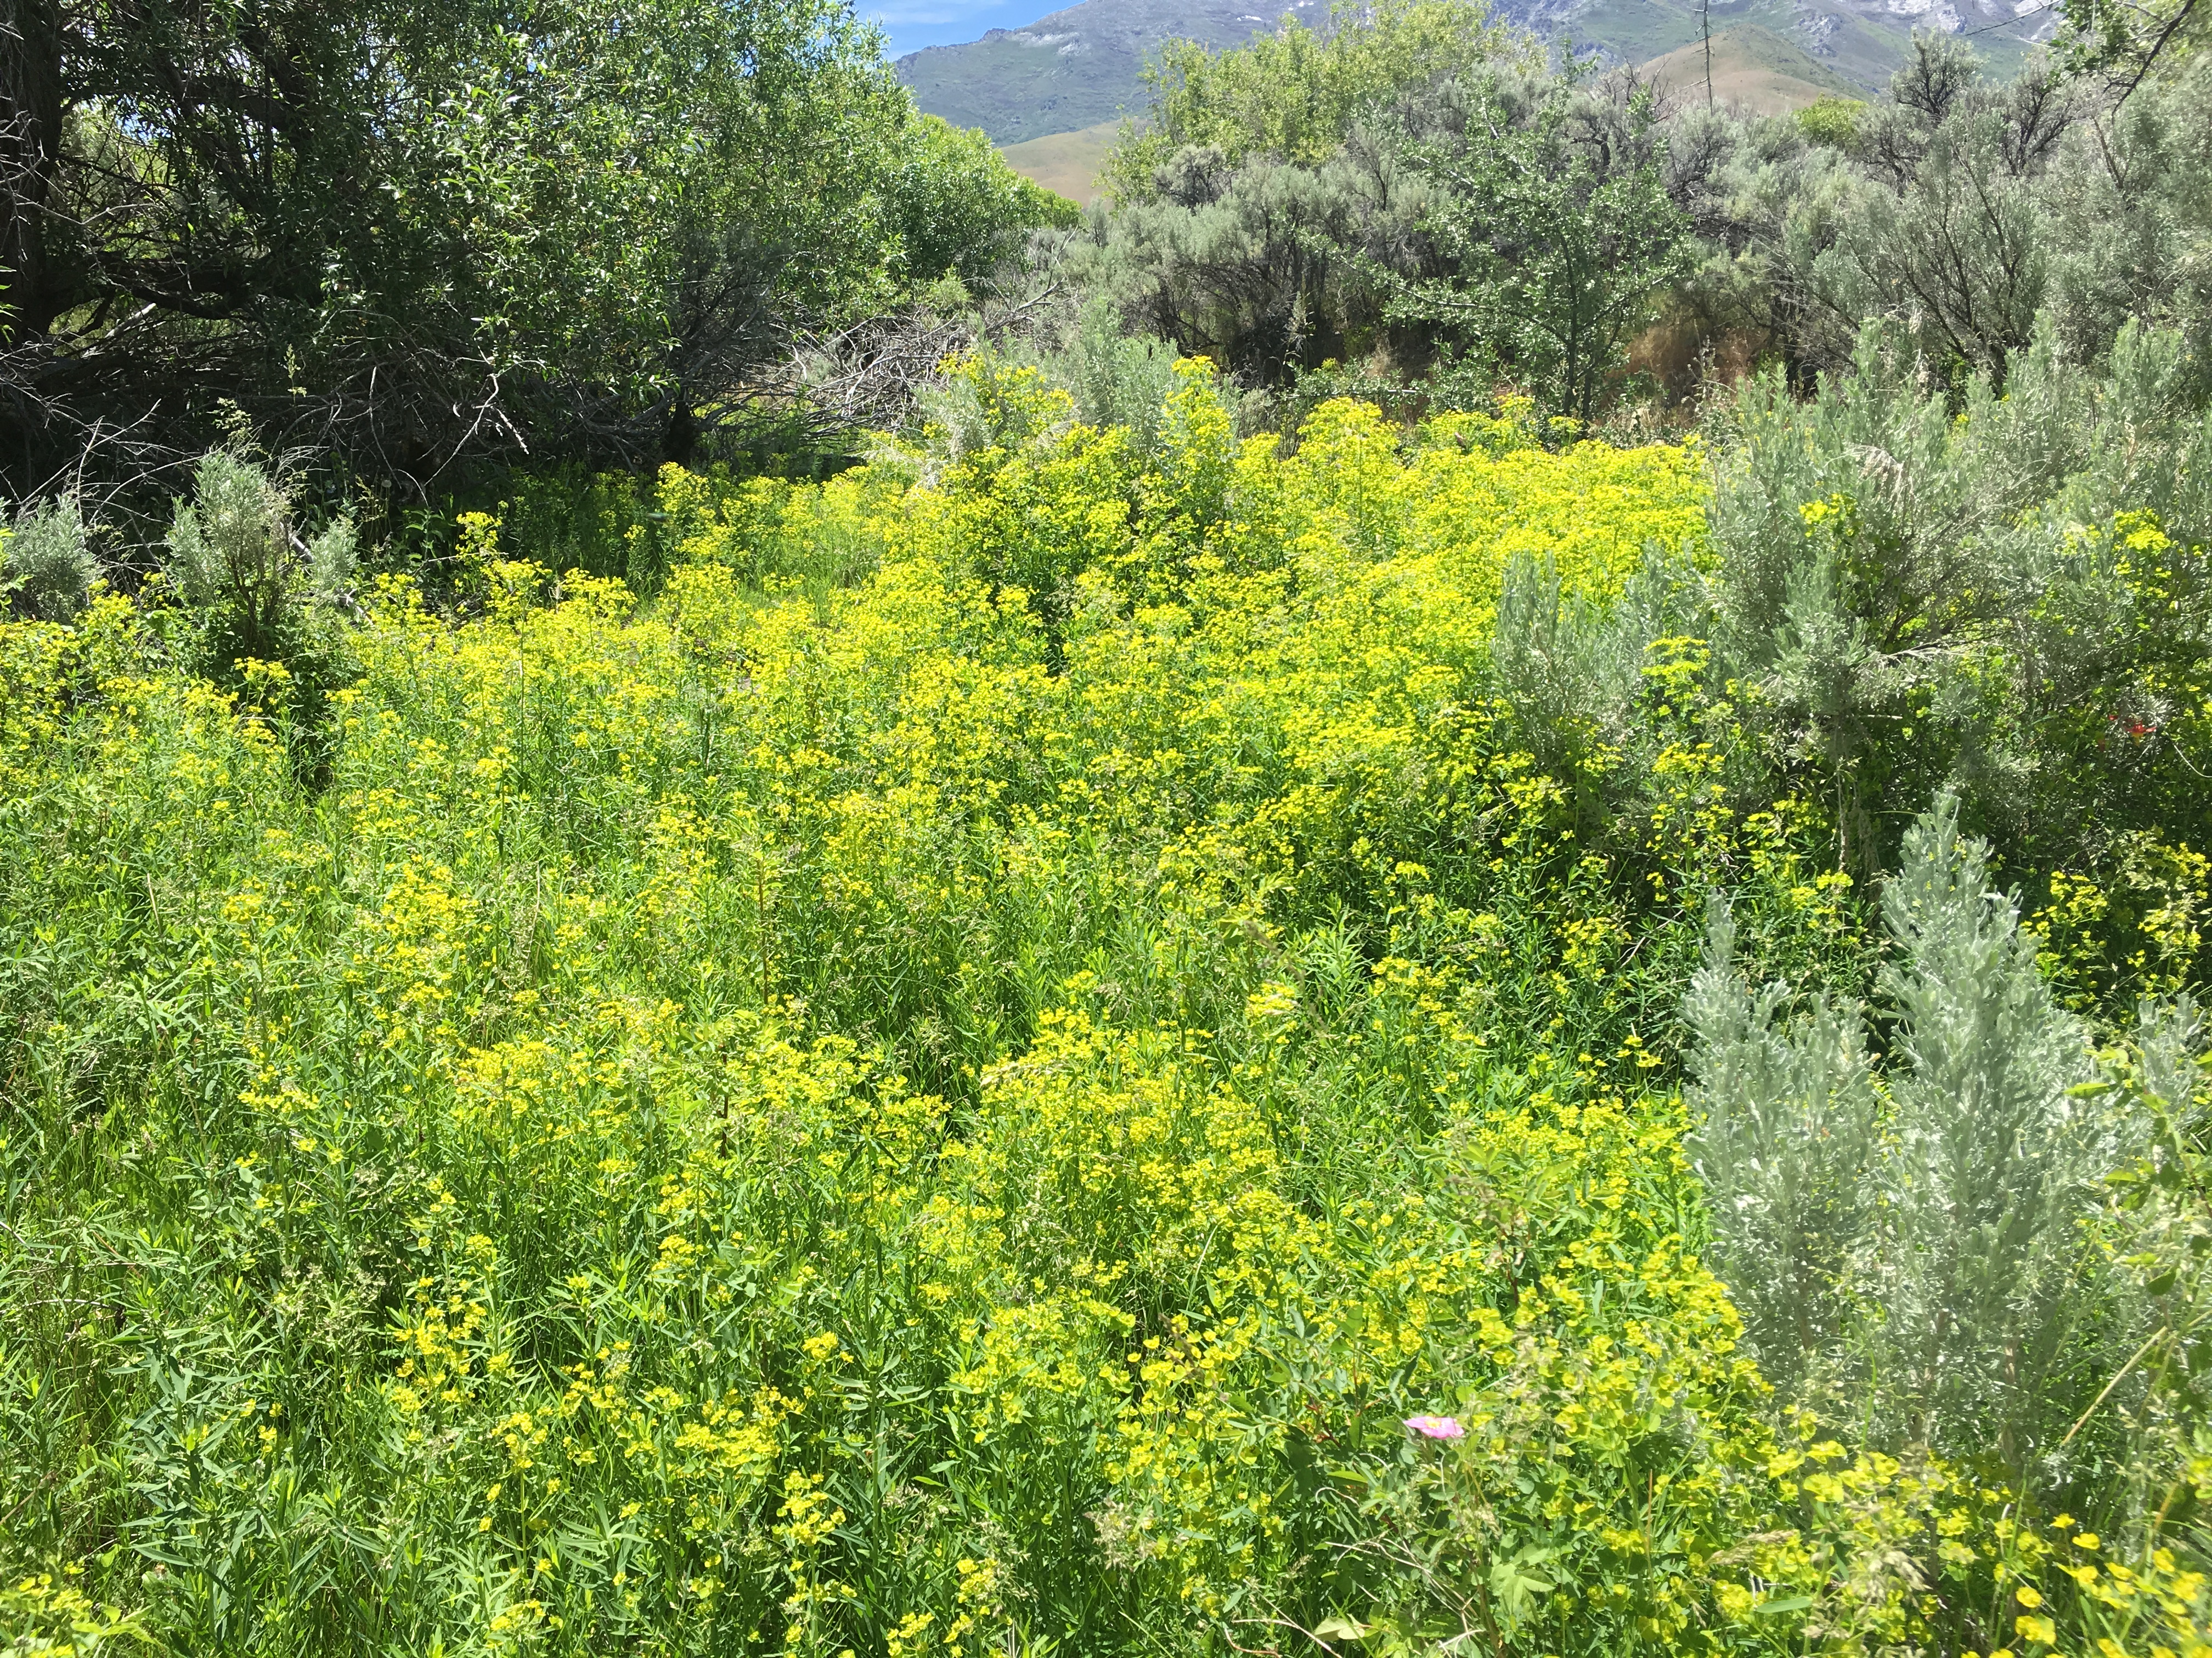
Identified Noxious Weeds
Hoary cress, Cardaria draba
Leafy Spurge:
Perennial
Creeping deep root system with new shoots rising above
More frequently found in pastures and near water ways.
Due to extensive root system and new shoot growth mechanical means not effective
Apply imazapic (Plateau) in fall after hard frost but before milky sap loss.

Slide 11
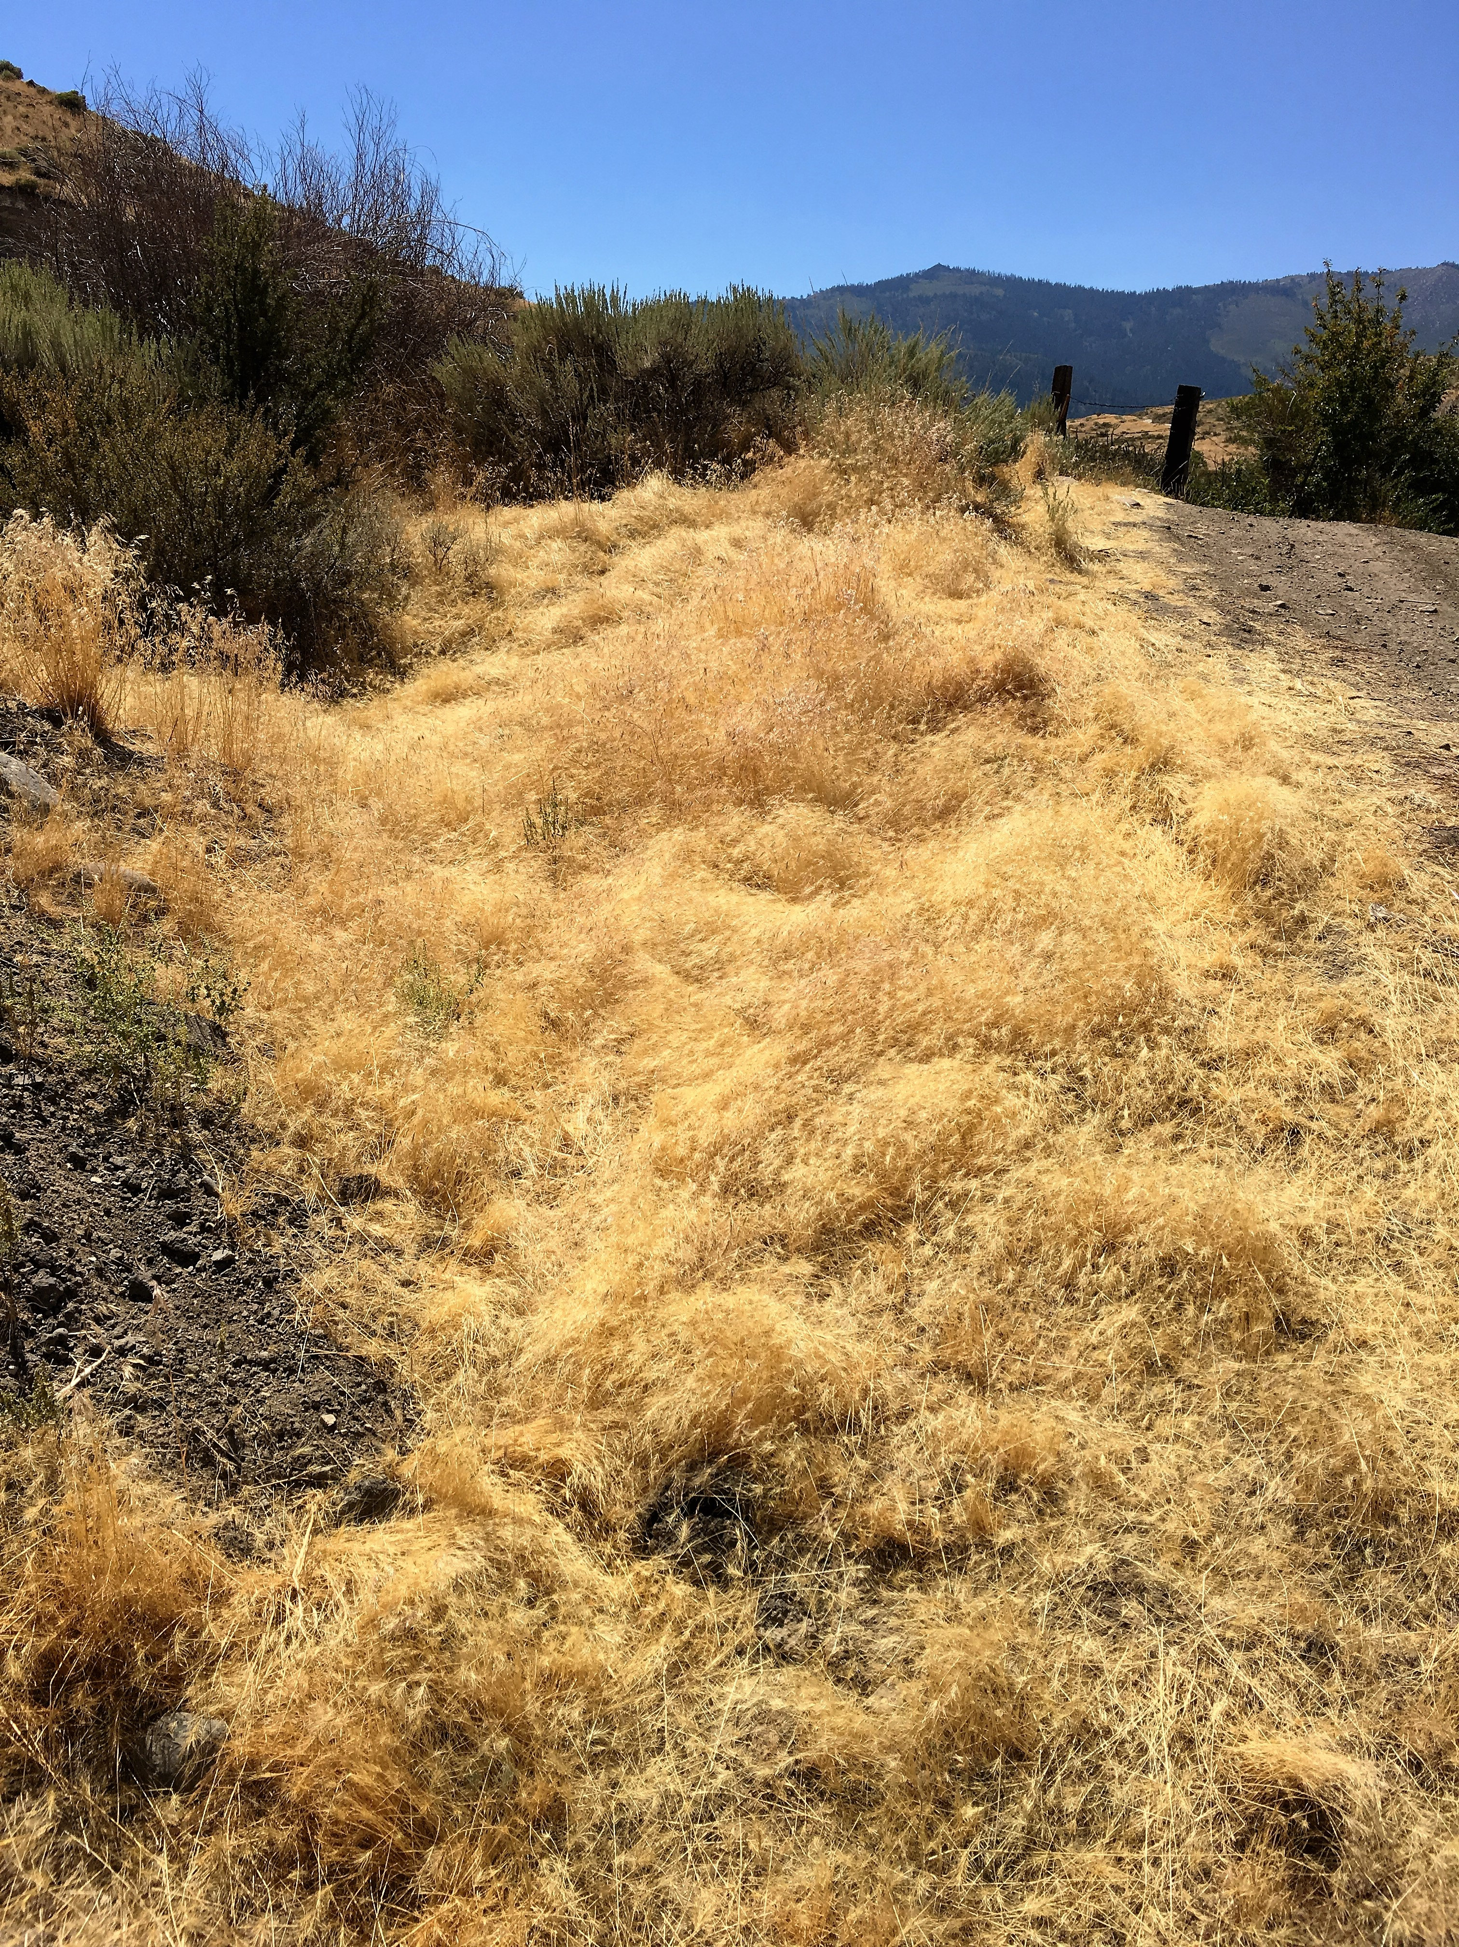
Identified Noxious Weed
Medusahead:
Winter Annual, Resembles Cheat Grass, spread by seed
Unpalatable to grazing animals due to its high silica content and stiff awns
Over time a thick dense layer of fibrous material develops
Remove thatch layer and treat ground early fall with herbicide containing imazapic

Slide 12
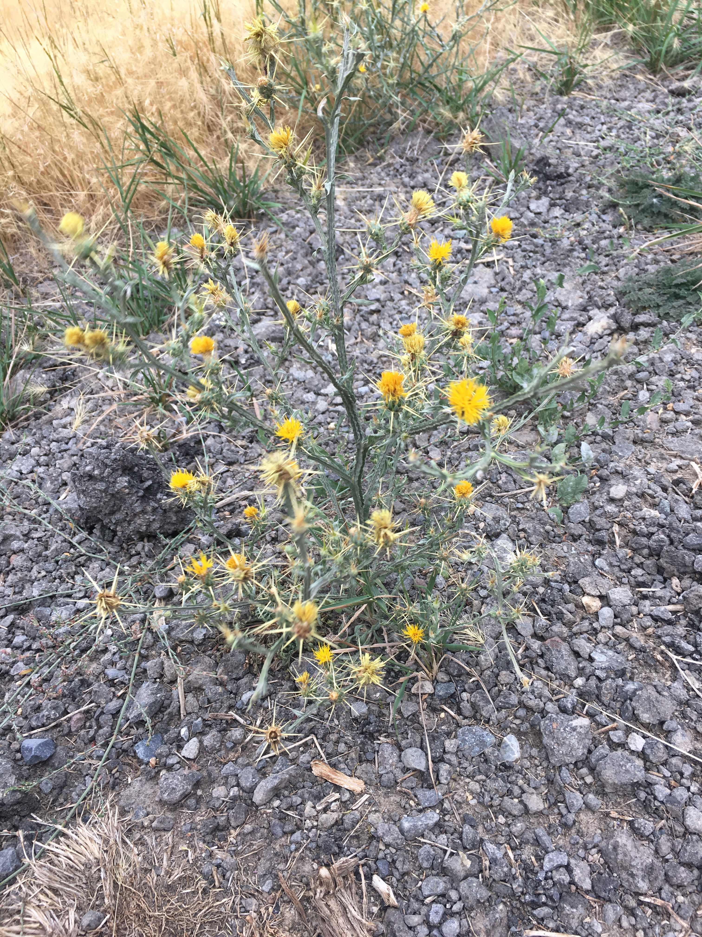
Identified Noxious Weed
Yellow Starthistle:
Annual
Spread by Seeds
Out of control in California
Manual removal can be effective if done prior to seed development
Apply herbicides prior to flowering

Slide 13
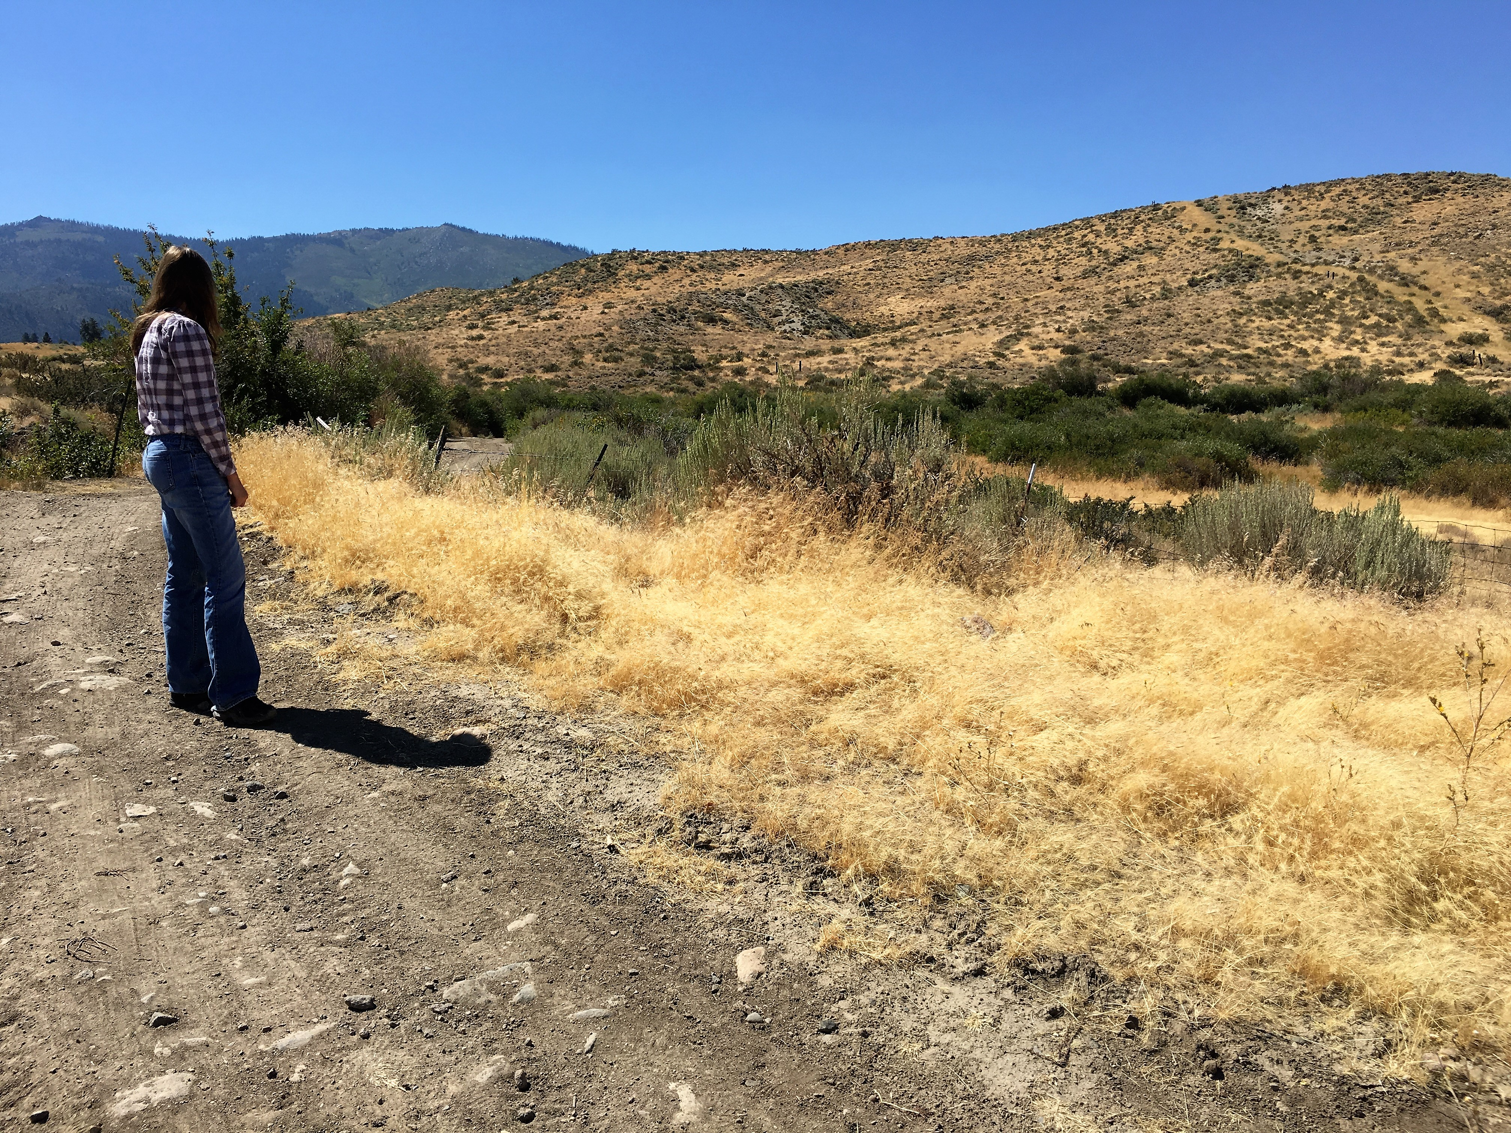
State and County Collaboration
Communications
Weed Survey Work
Mapping
Weed Control
Prioritization

Slide 14
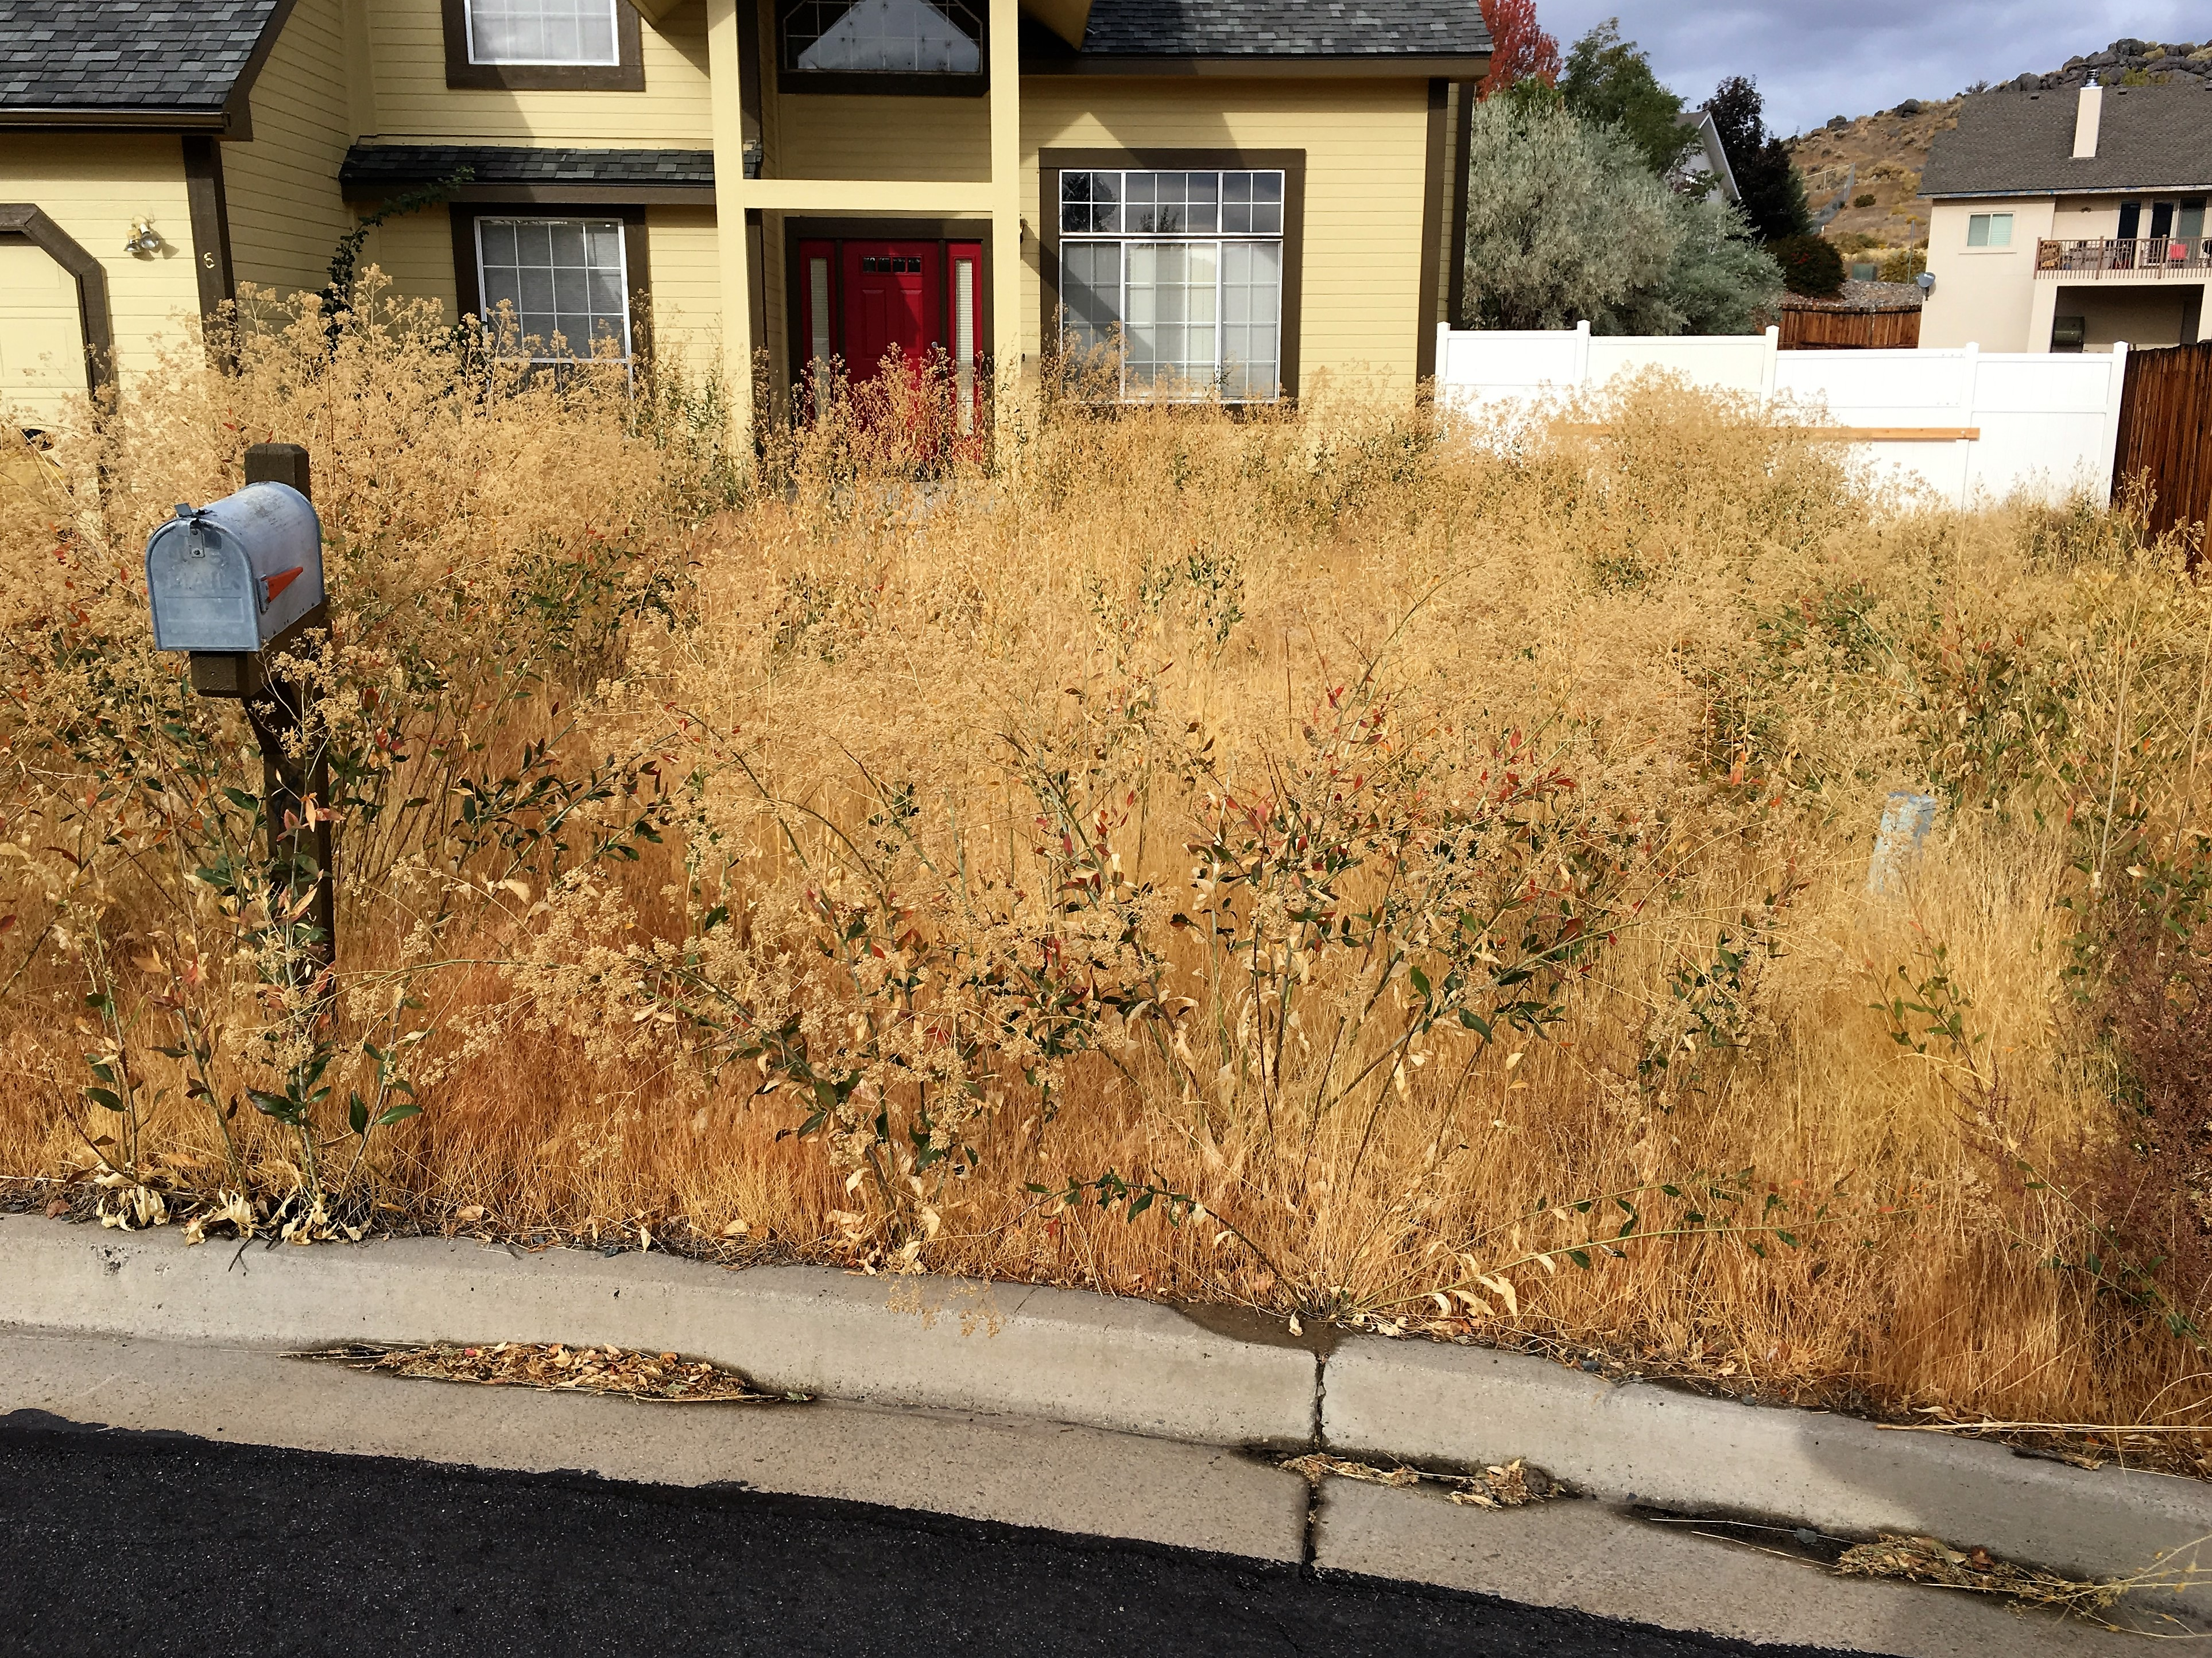
State and County Collaboration
Noxious Weeds Program Cost Share Abatement Program
Covers 80% of costs following Abatements
Property Liens must be filed
Identifies the Weed(s) Needing Control
Provides Specified Weed Management Plan

Slide 15
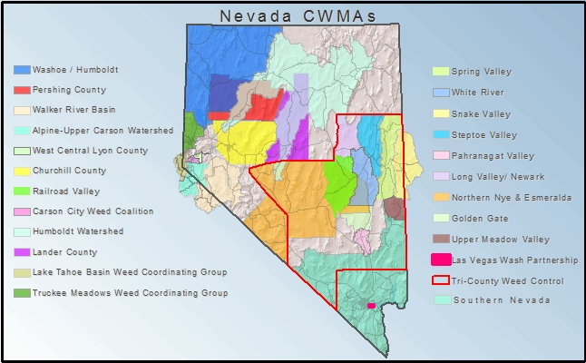
State and County Collaboration
Conservation Districts
Weed Districts
CWMAs
USFS Grants

Slide 16
Weed Districts
NAC 555.035 through NAC 555.095: Weed Control Districts:
Paradise Valley Weed Control District
Ruby Weed Control District
Diamond Valley Weed Control District
Douglas County Weed Control District
Goose Creek Weed Control District
Lovelock Valley Weed Control District
Walker River Weed Control District
Lamoille Weed Control District

Slide 17
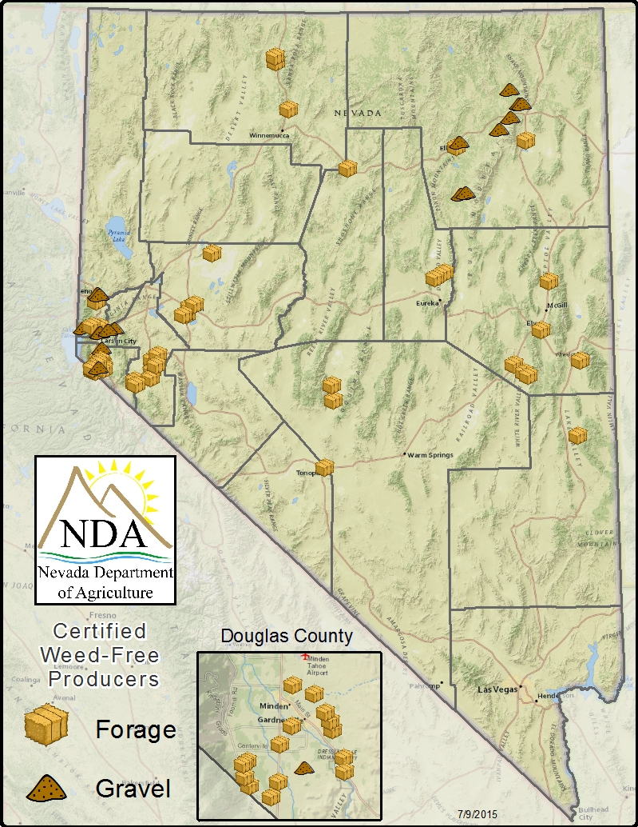
State County Collaboration
Weed Free Gravel and Weed Free Hay Certification Program:
Required for use when feeding mules and horses kept on federal lands
Required for use in fire restoration sites
Required for use in federal construction projects
Increases value of product
Limits spread of noxious weeds

Slide 18
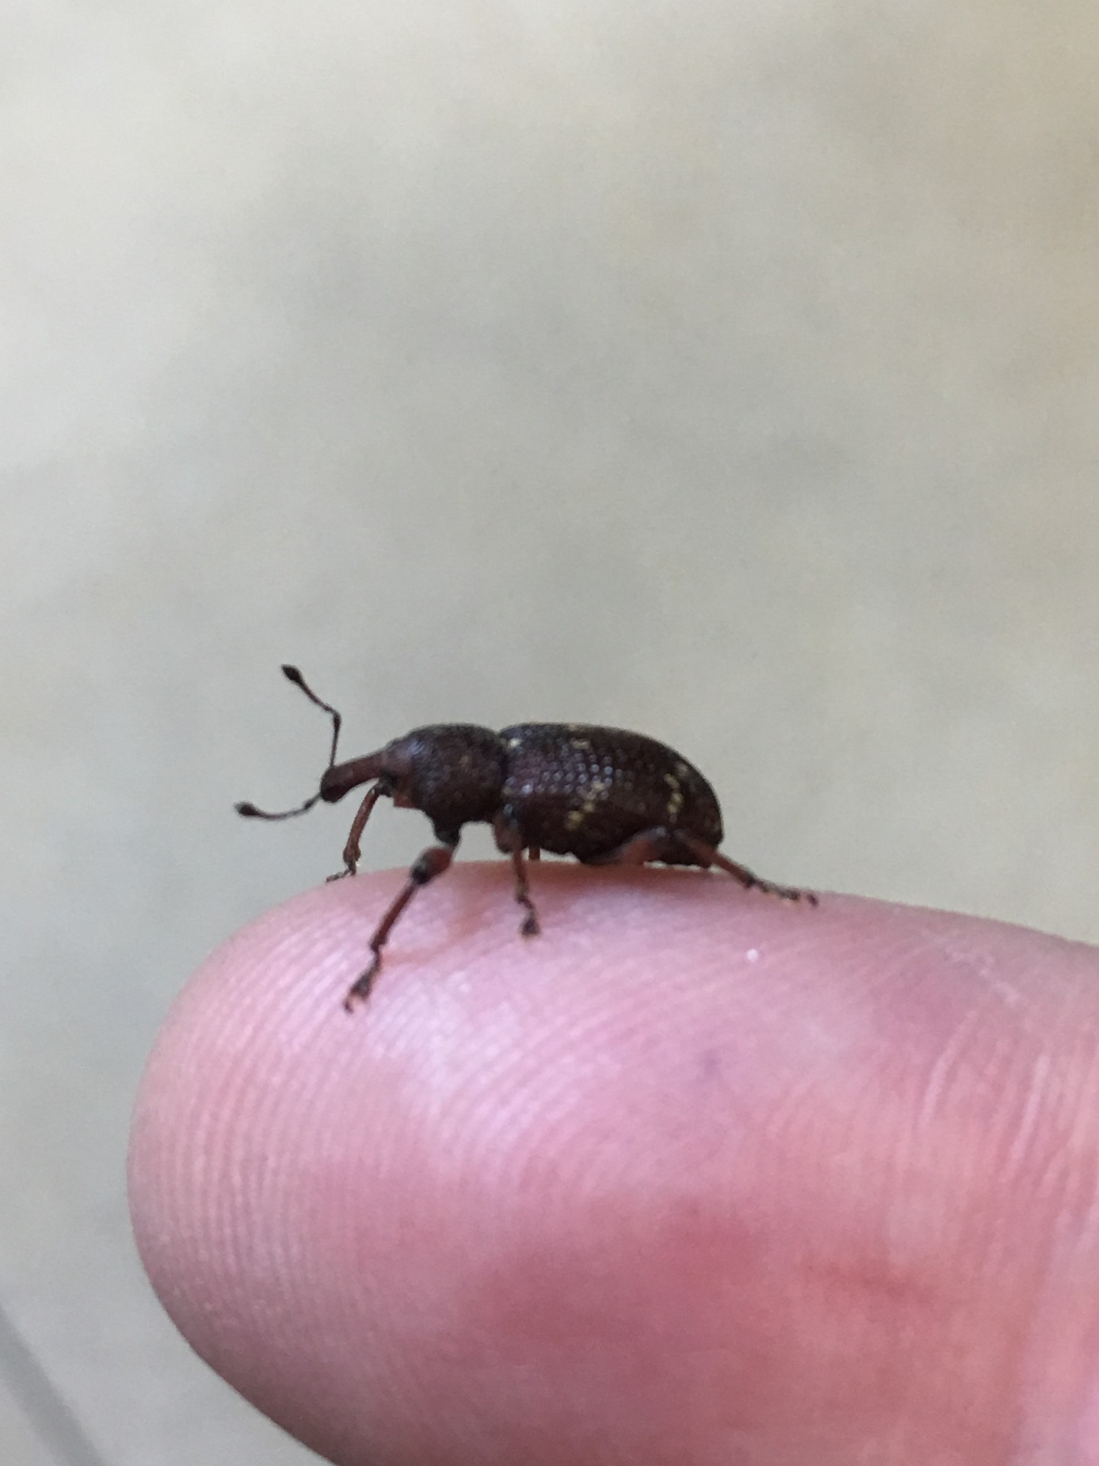
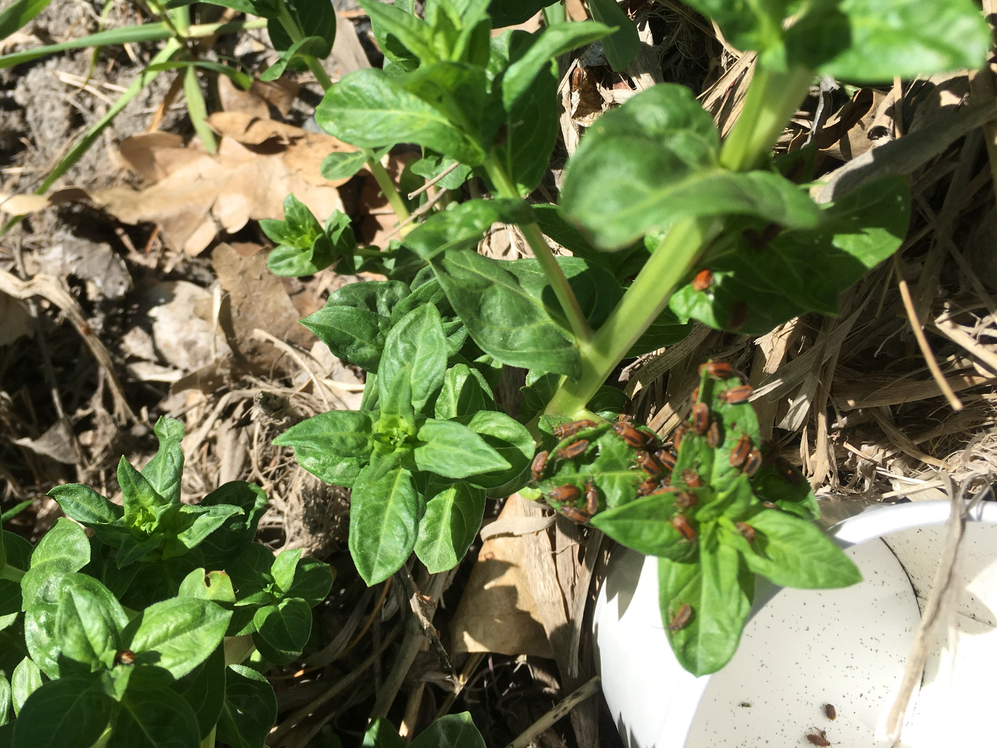
Possible Assistance: Bio-Control Releases
Biological Control Agents:
USDA tested biological control agents can be insects, funguses, or bacteria that restrict further growth of noxious weeds. These agents are host specific not to damage other plant life. A few agents available are:
Purple Loosestrife Root Weevil
Purple Loosestrife Beetle

Slide 19
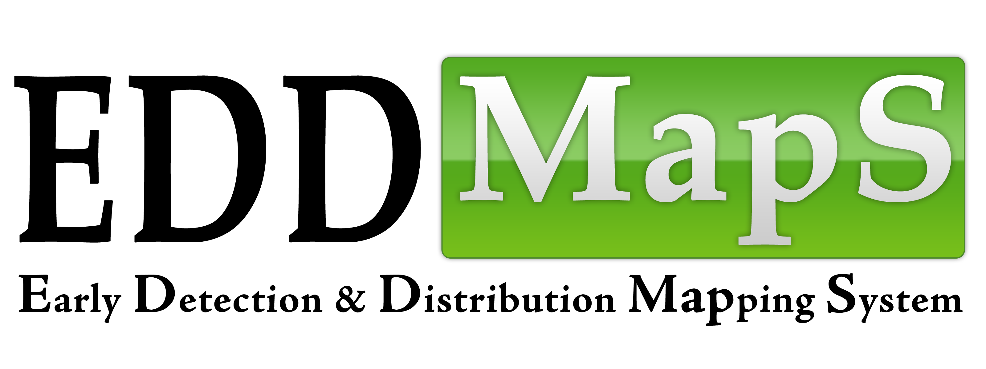
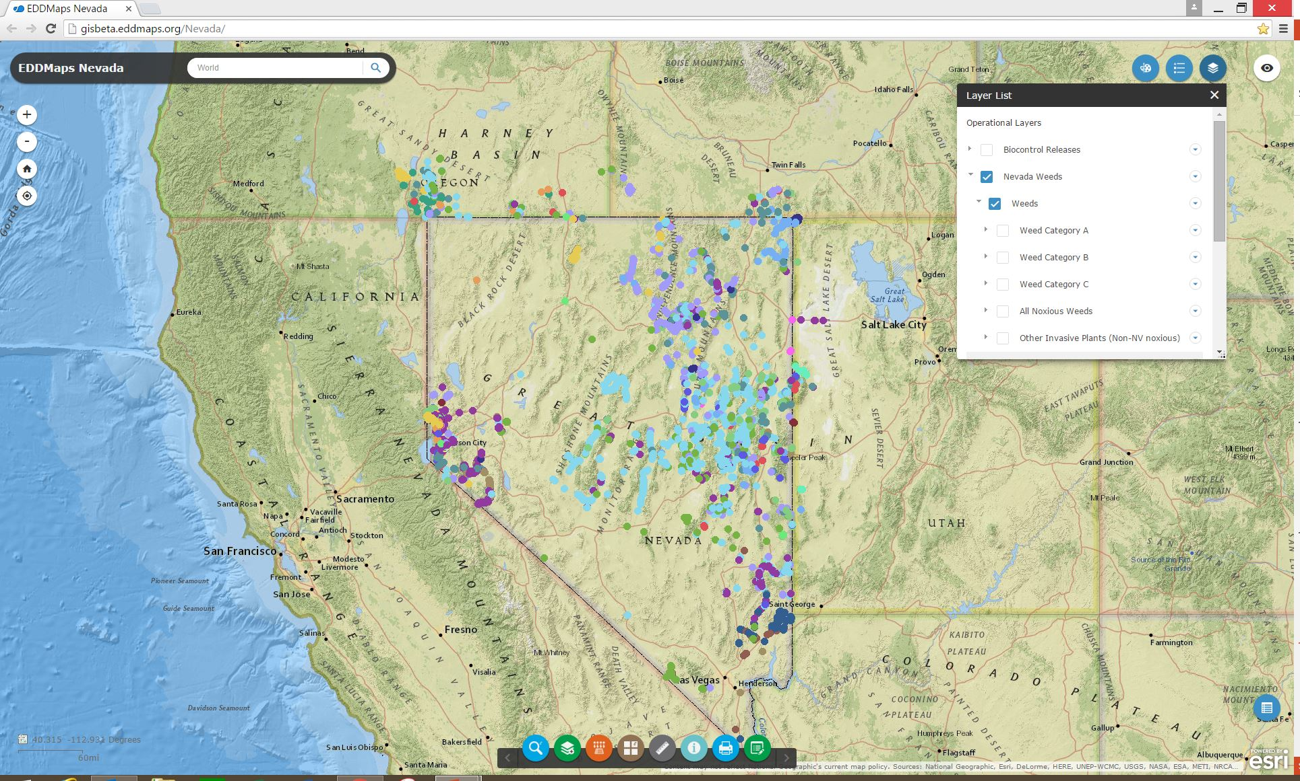
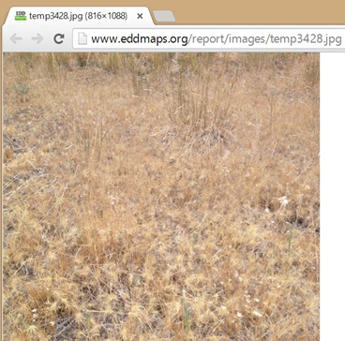
Reporting: NDA Website &
Public can report noxious weeds through cell phone or website and record:
GPS location
Picture of the plant or plants
Approximate size of infestation
Any additional data included by submitter

Slide 20
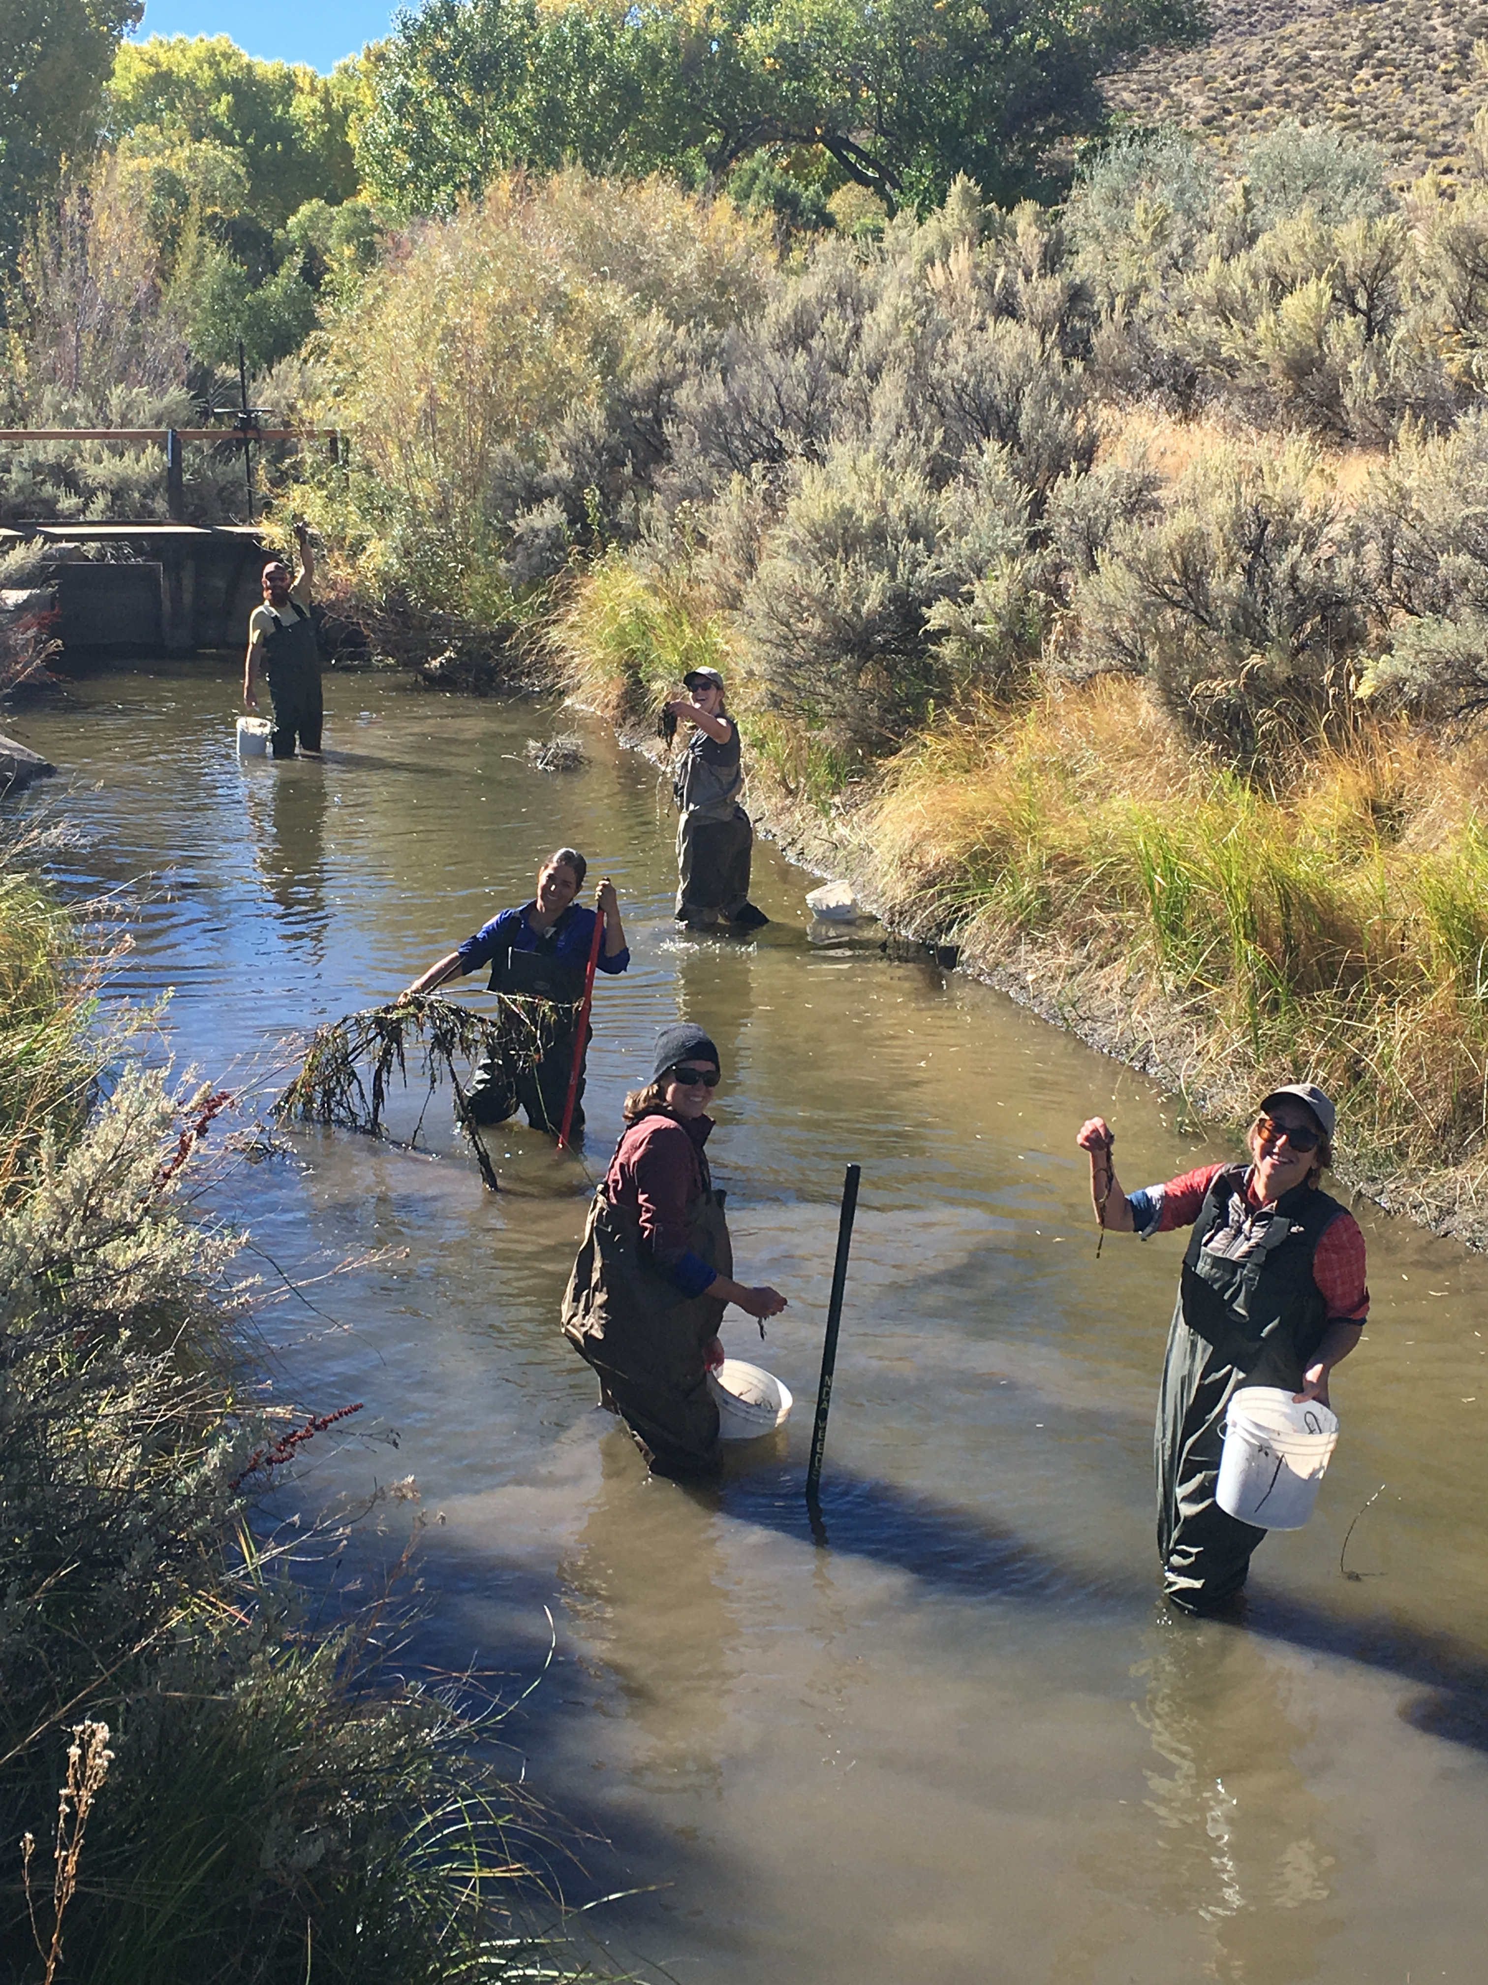
Challenges County Weed Crews Face
Fire Fuel Accumulation
Spreading via Traffic
Public Perception
Public Health
Difficult Access
Funding Shortages
Chemical Storage
Absent Landowners

Slide 21
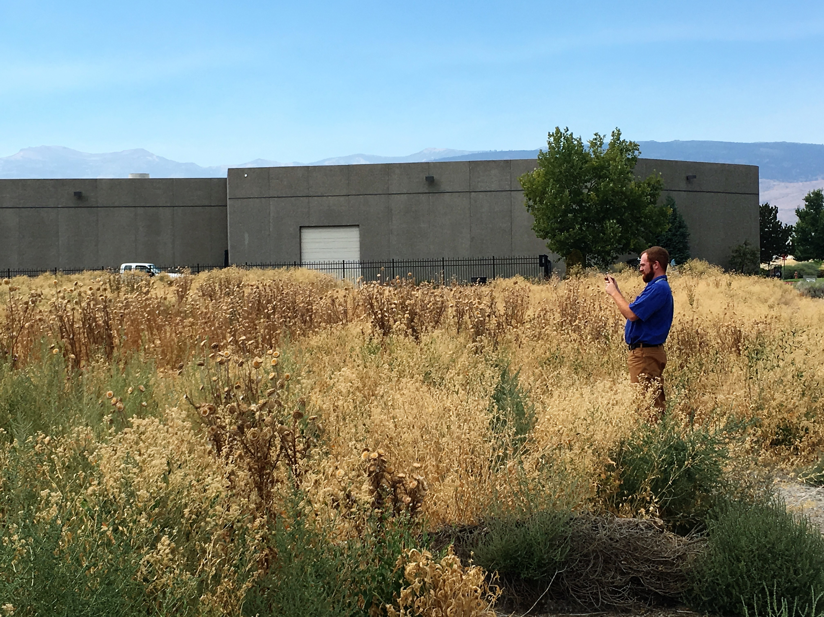
Resources are needed
Through necessary funding sources, weeds are controlled on:
County Roads and Rights of Ways
Open Spaces and Parks
Private Land Owners !
Which cover:
Herbicides
PPE
Storage
Equipment
Personnel

Slide 22
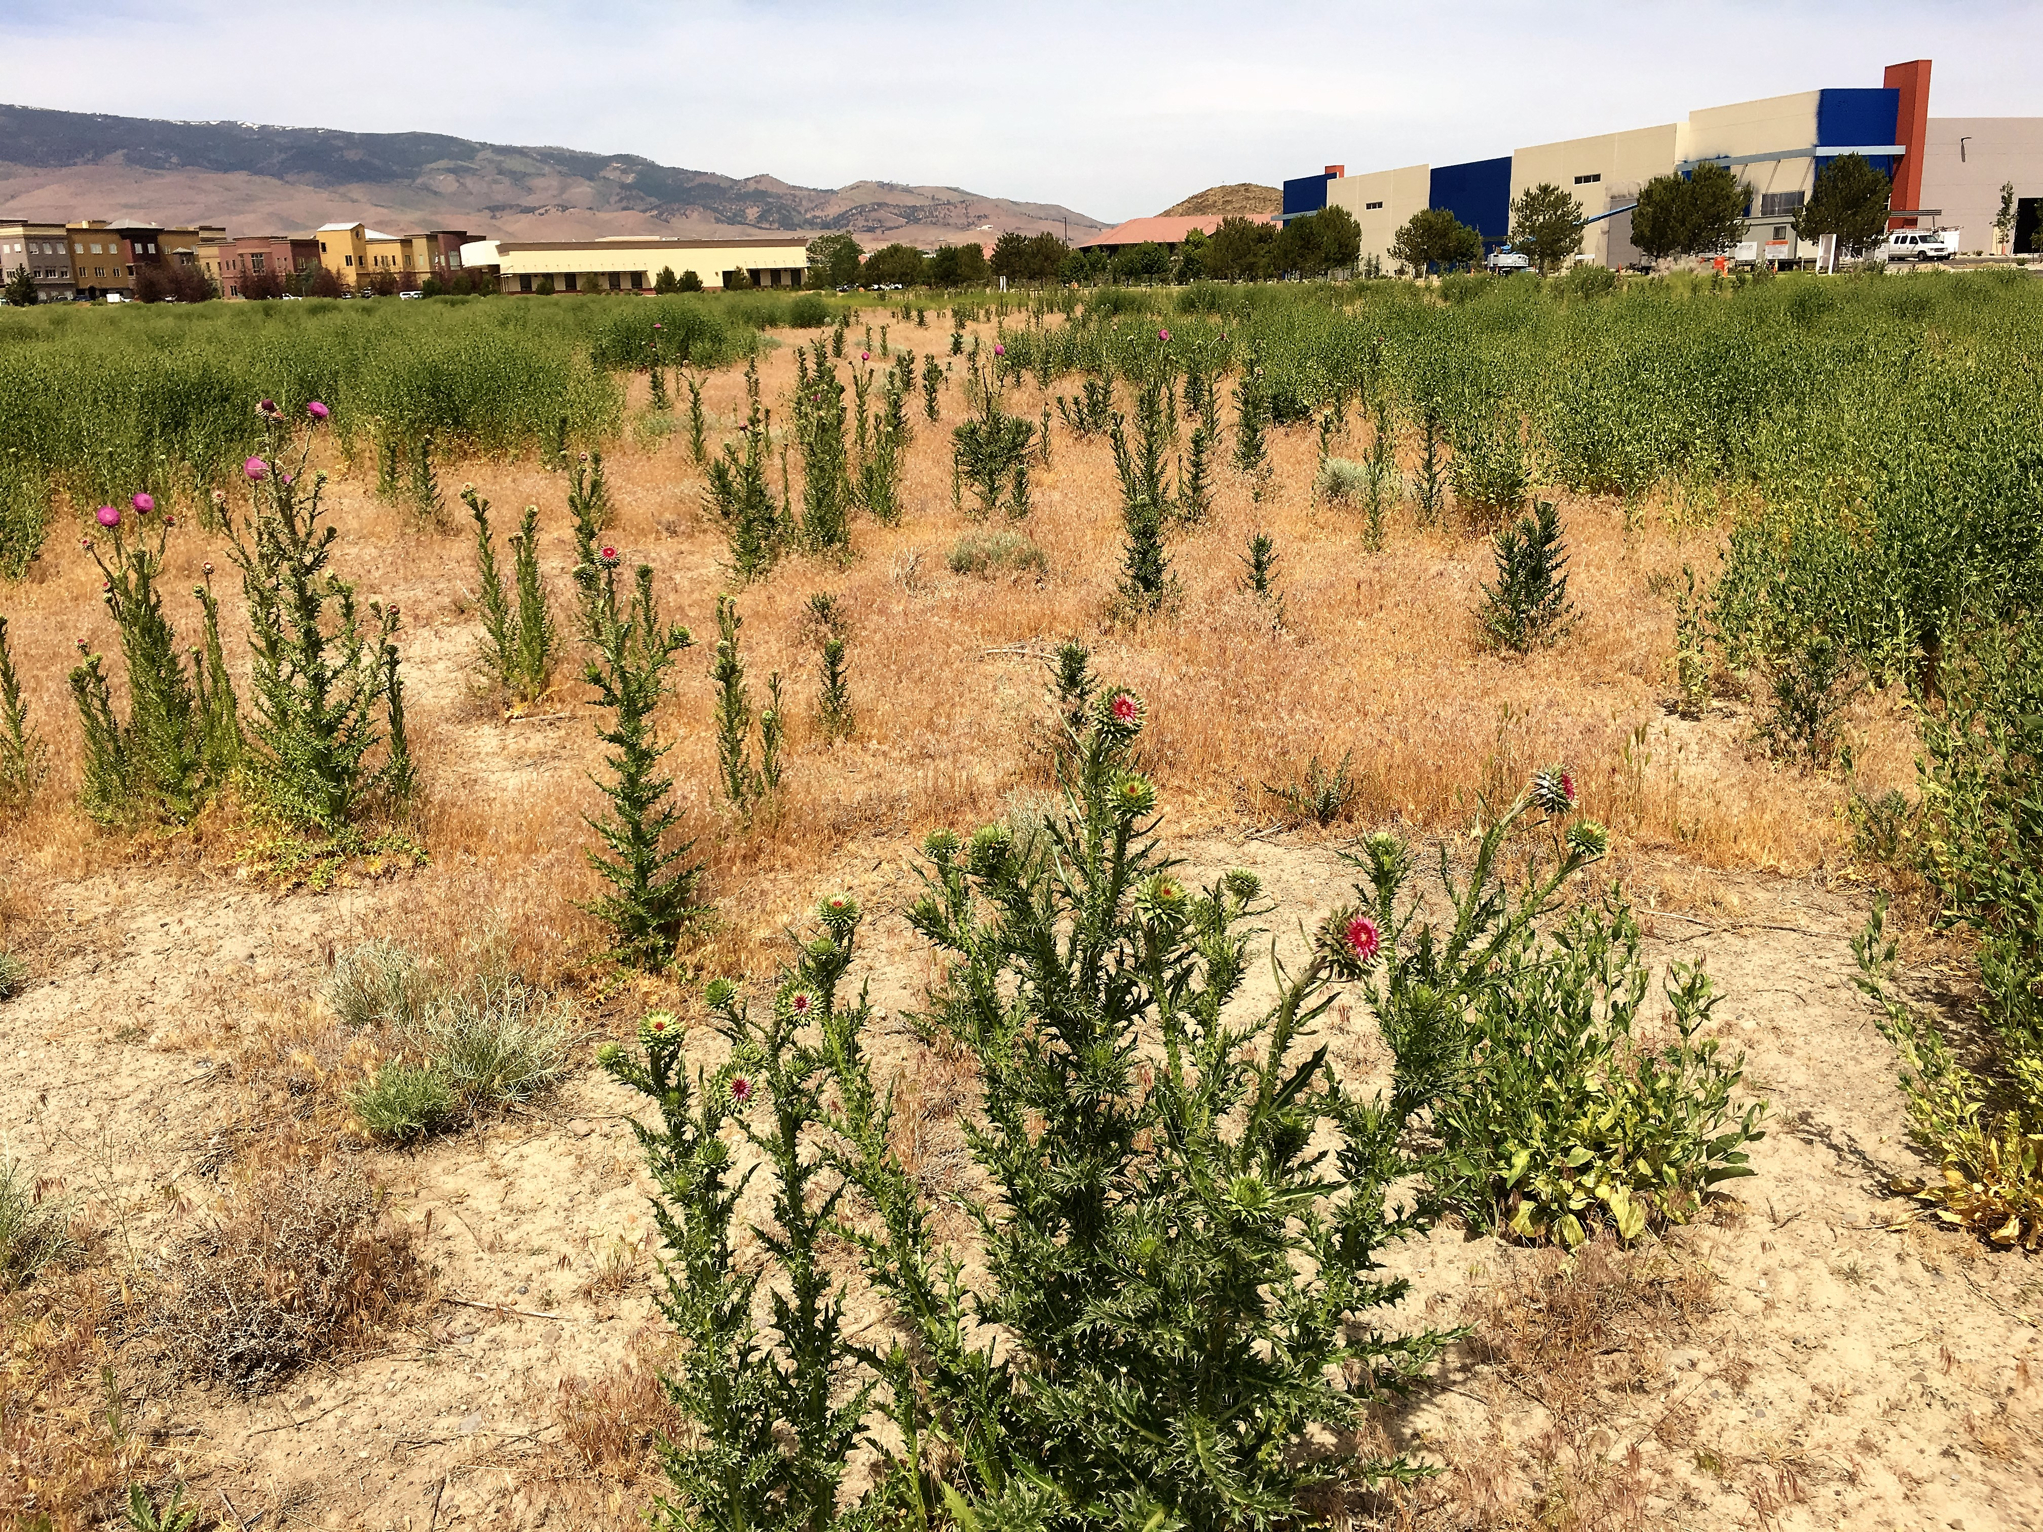
Why Be Concerned?
Decline in :
Native Plant Species
Wildlife Habitat
Agricultural Yields
Property Values
Water
Your Pocket Book

Slide 23
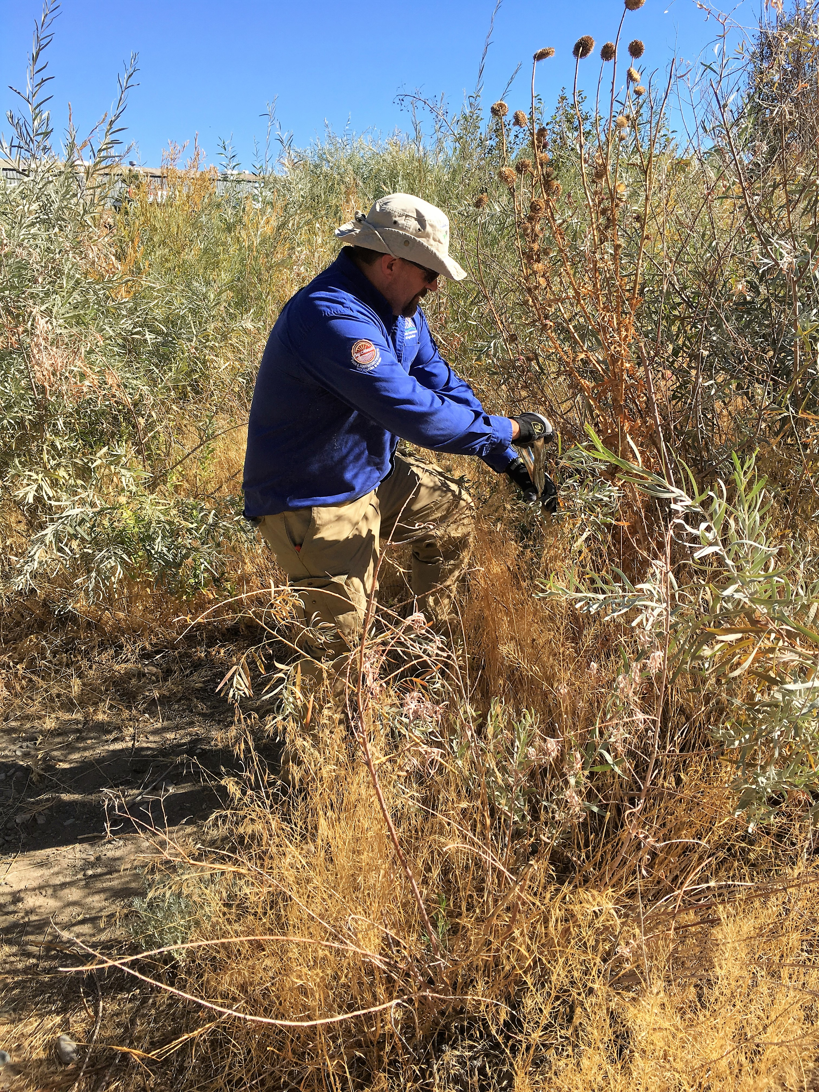
Thank you
Sean Gephart
Nevada Department of Agriculture
(775) 353-3640
Sgephart@agri.nv.gov

